Slide 1
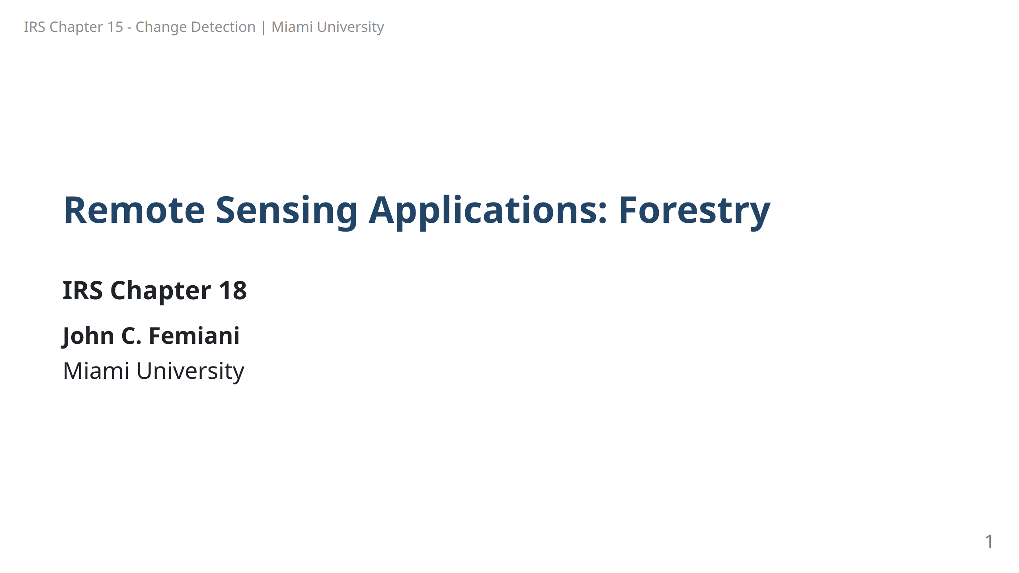

Slide 2
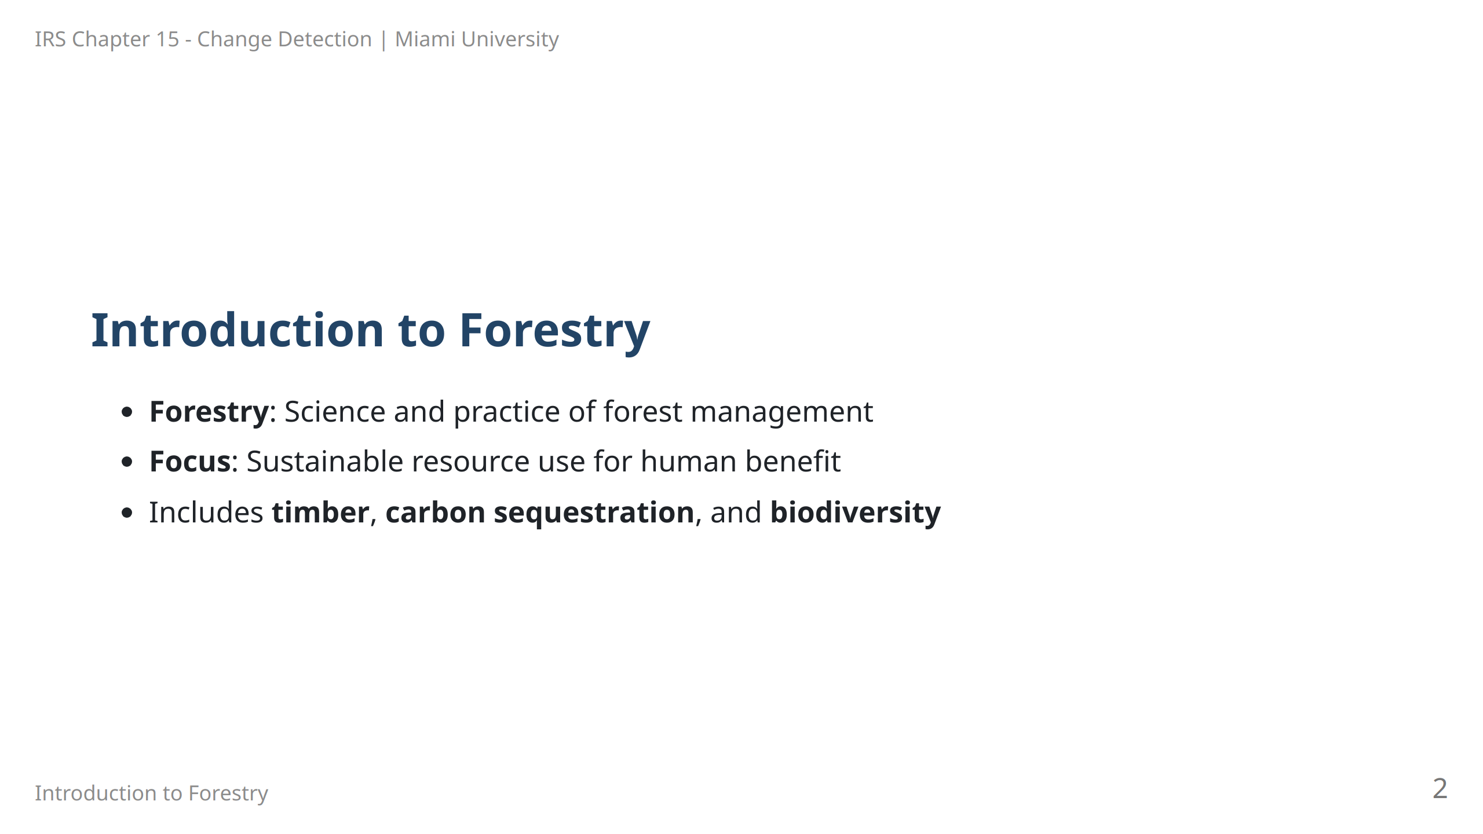
Notes:
Speaker Notes: Forestry is the profession that integrates science and practice to manage forests sustainably. This includes using forest resources for timber, water, carbon sequestration, and conservation of biodiversity. The field has evolved to encompass various management objectives for environmental and economic benefits.

Slide 3
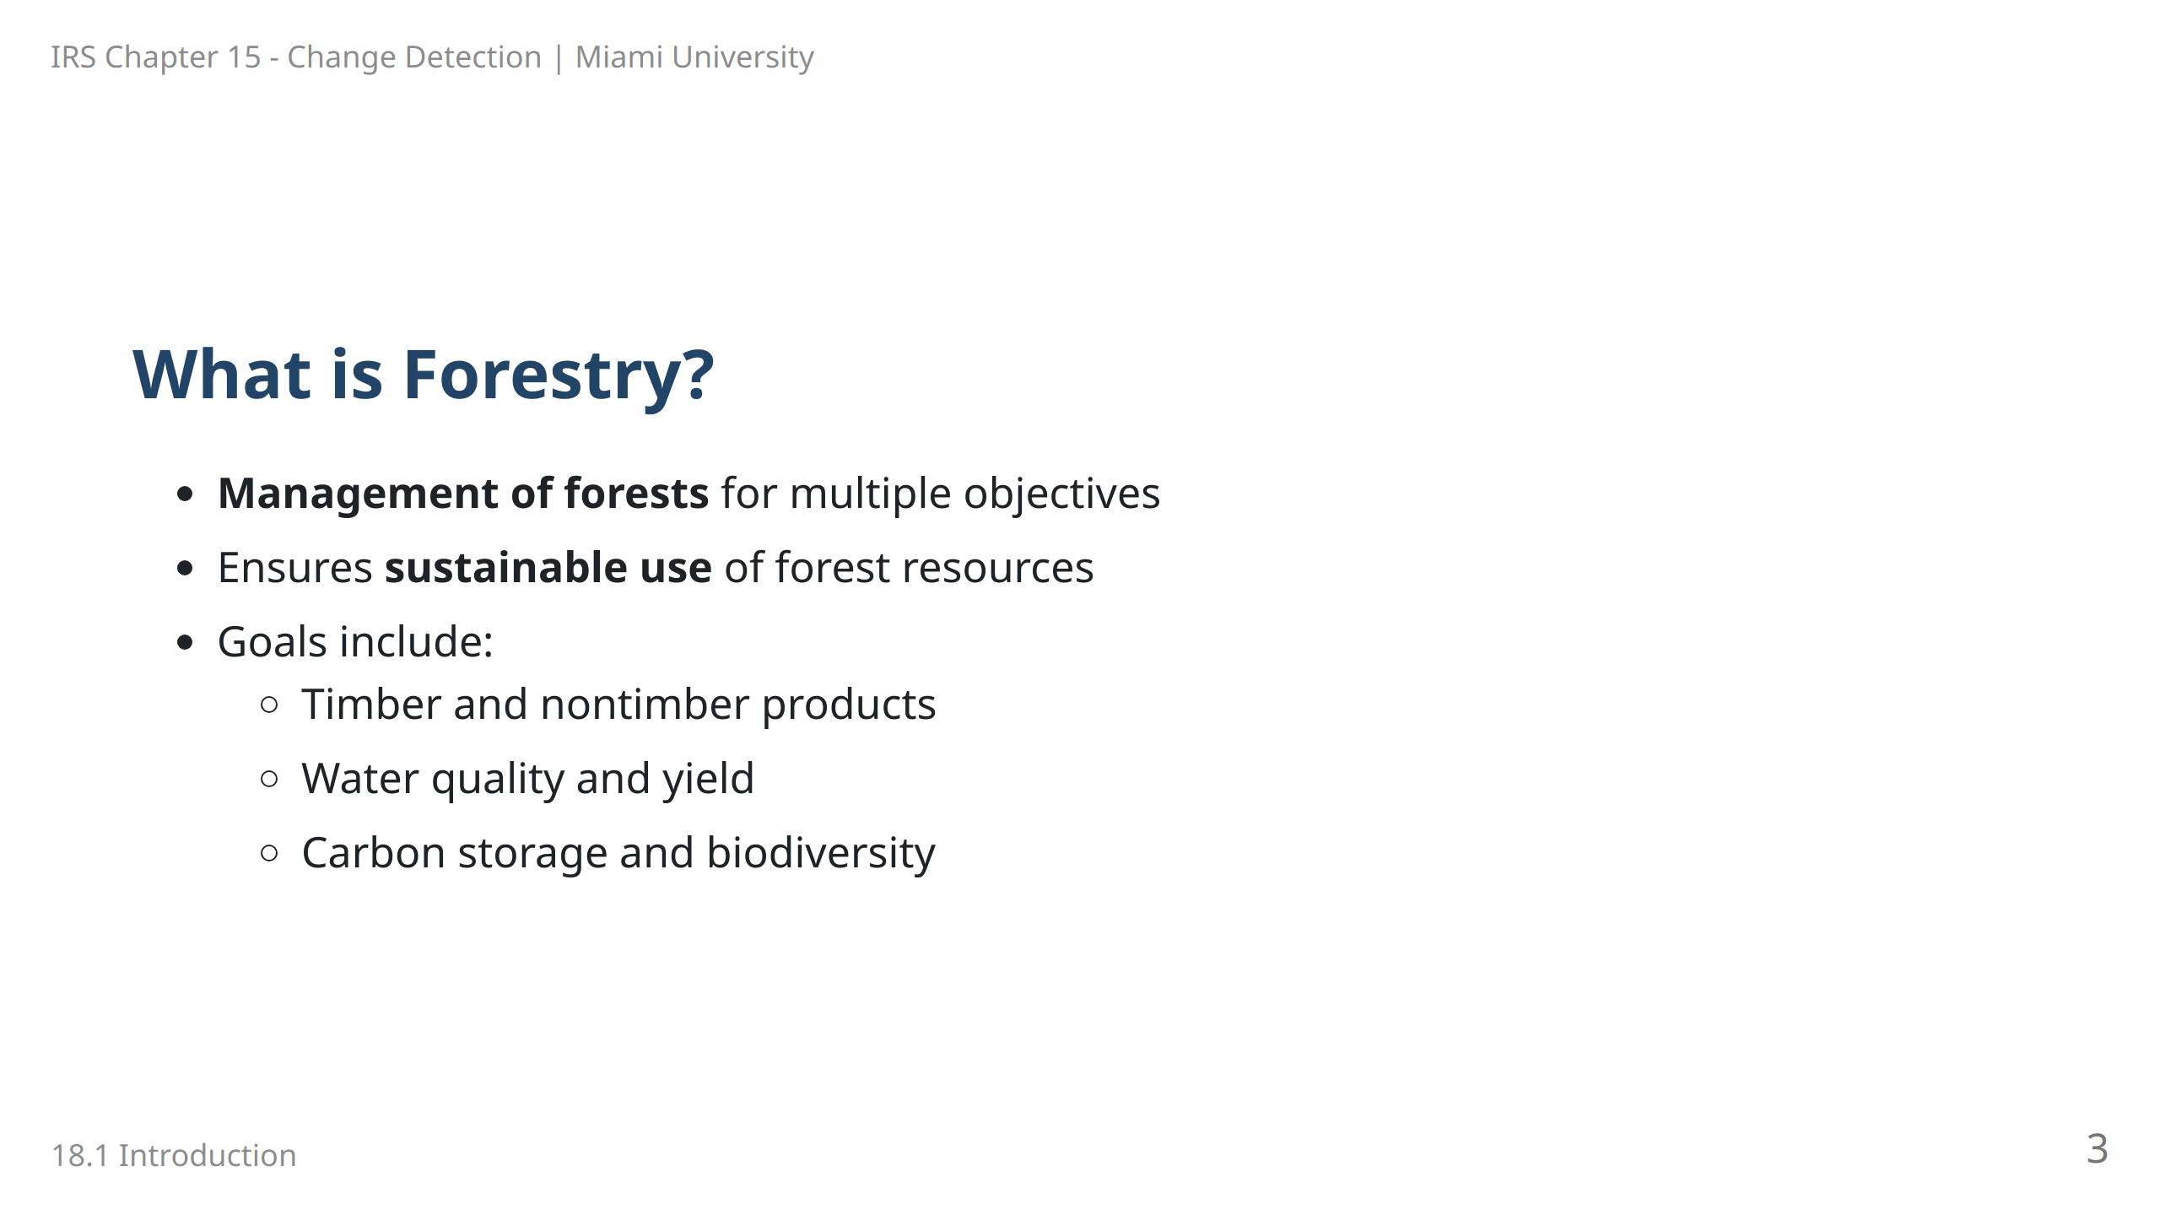
Notes:
Speaker Notes: Forestry involves managing forest resources for diverse objectives that range from timber production to water management and biodiversity conservation. It emphasizes sustainable practices that ensure long-term benefits to society and ecosystems.

Slide 4
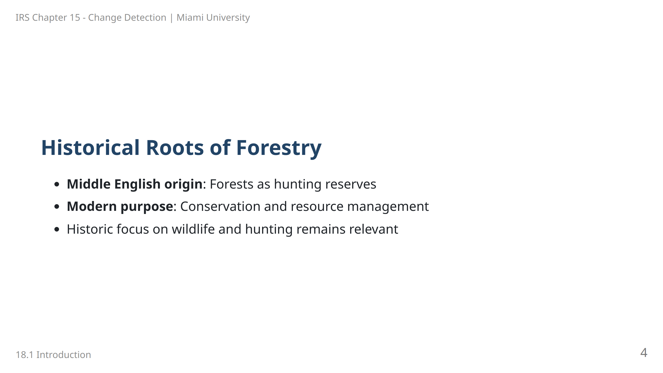
Notes:
Speaker Notes: Originally, forests were reserved areas for hunting, as indicated by the Middle English term "forest." While the historic purpose has expanded, the management of forests for wildlife is still an essential objective in modern forestry.

Slide 5
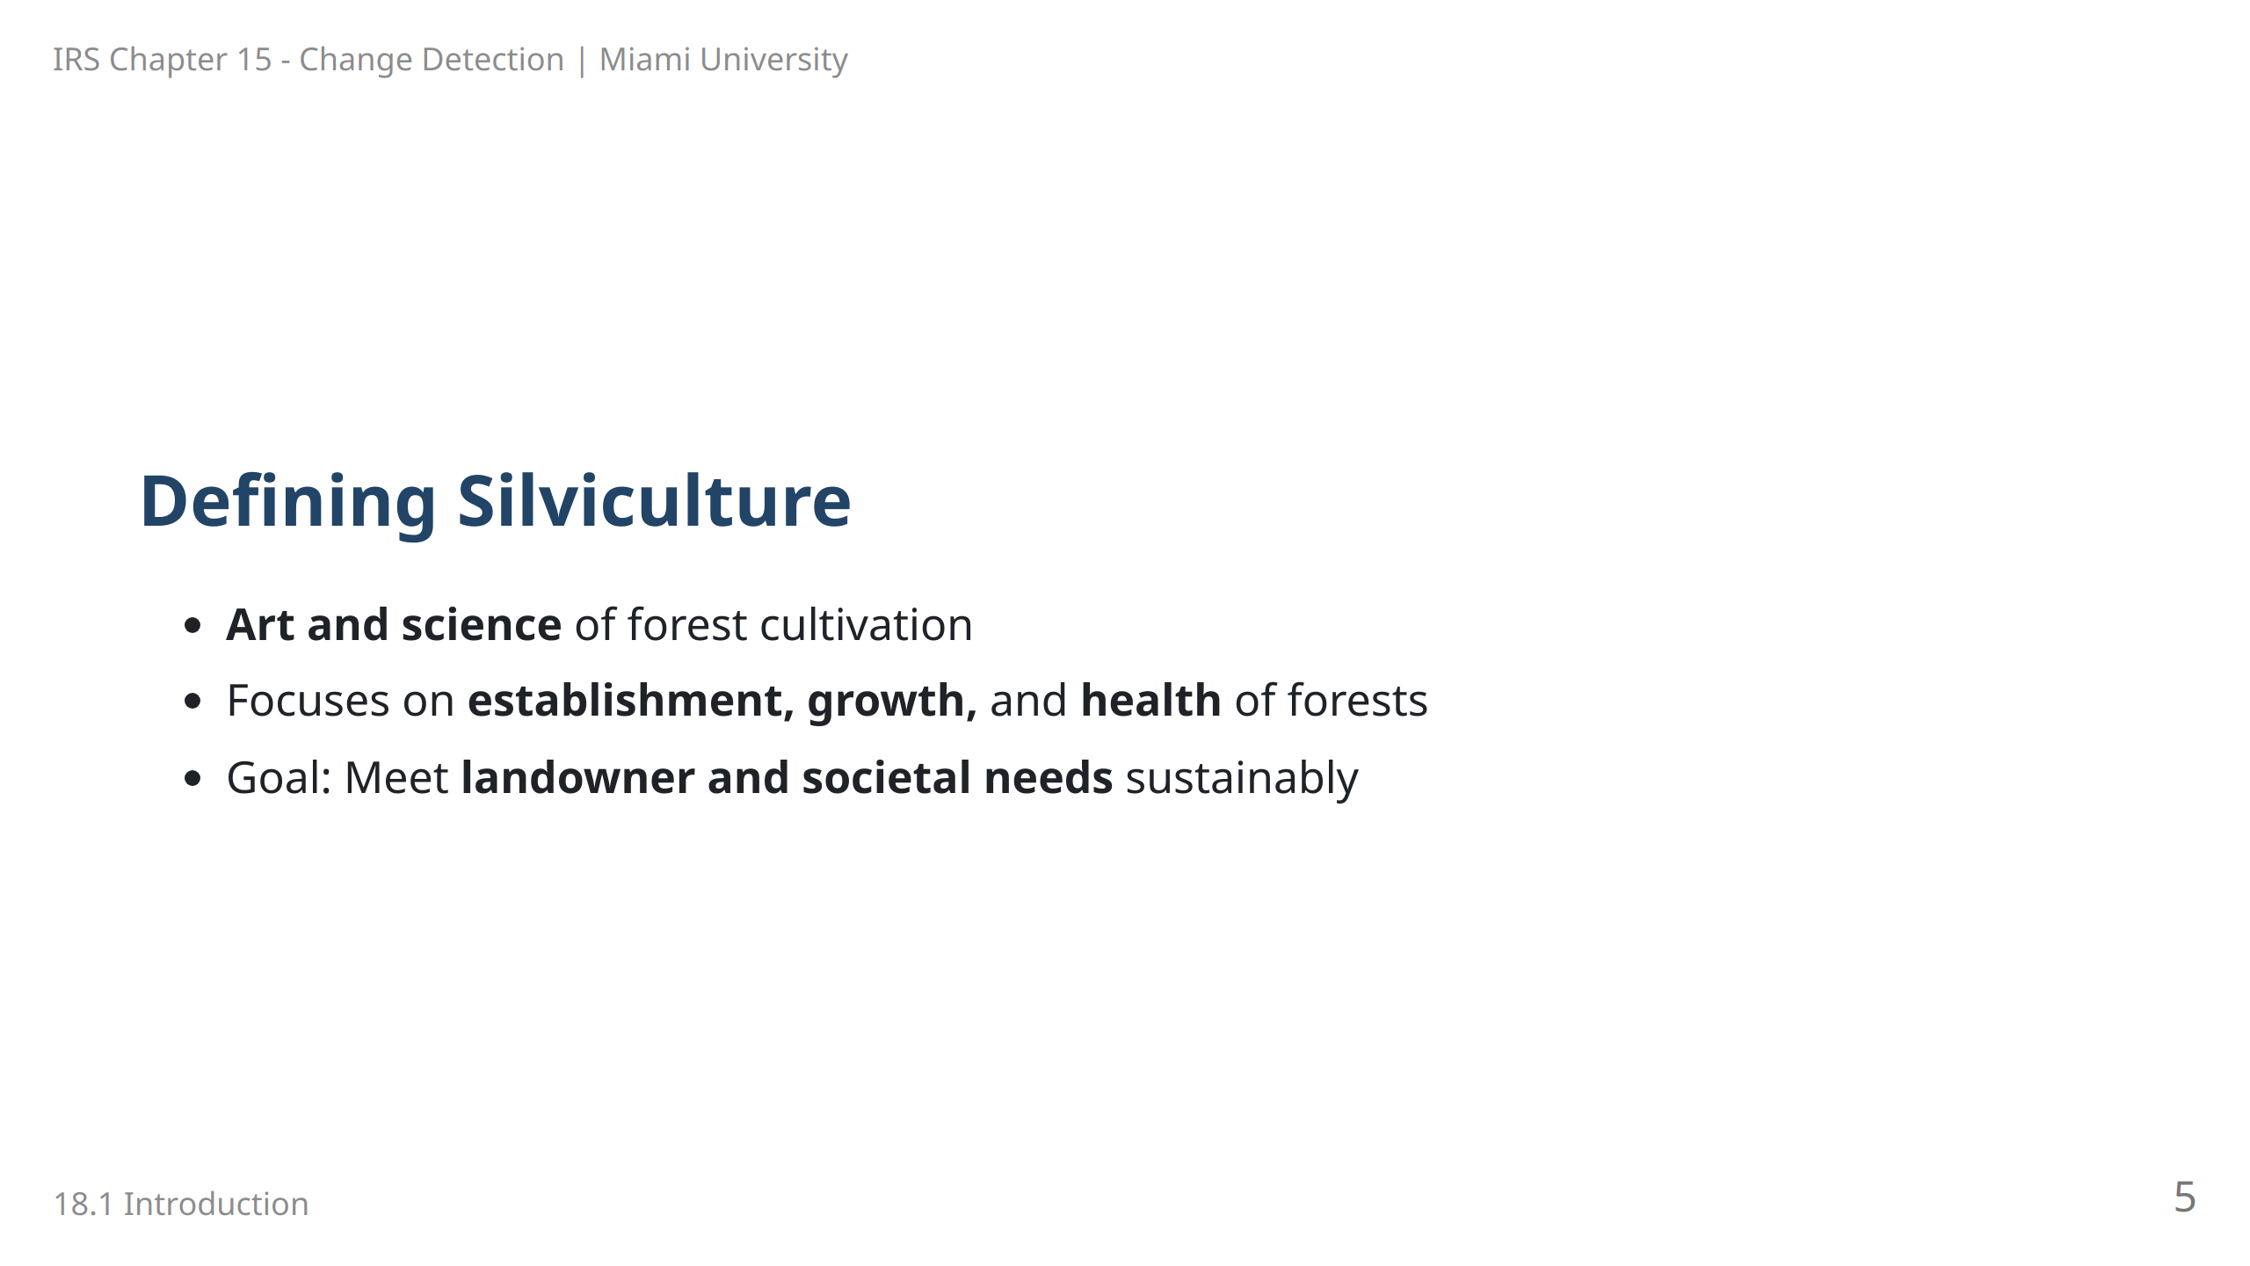
Notes:
Speaker Notes: Silviculture is a core component of forestry, focusing on the controlled cultivation of forests. It aims to manage forests for health and productivity, ensuring they meet the long-term needs of both landowners and society.

Slide 6
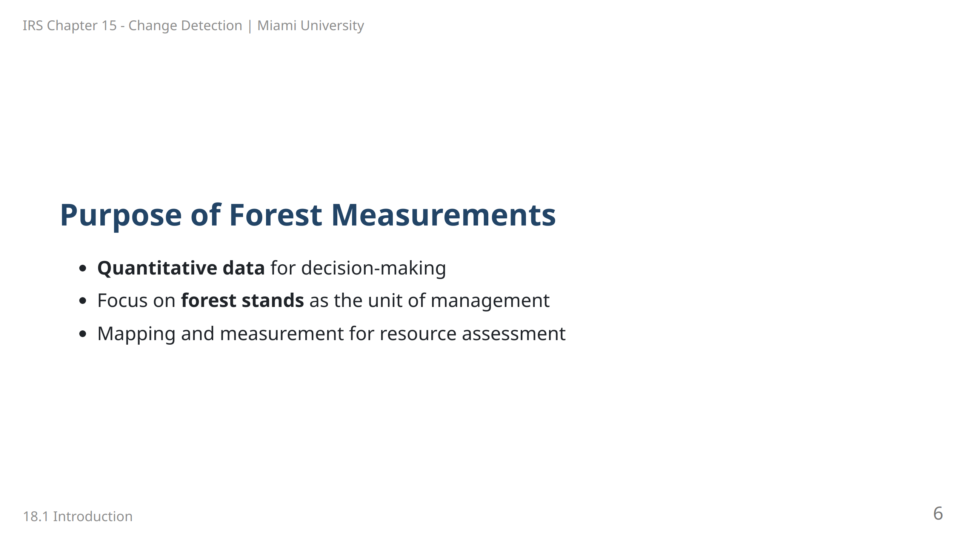
Notes:
Speaker Notes: Forest measurements provide critical data for effective management. The basic unit of management, known as a forest stand, represents a group of trees with similar characteristics, which can be mapped and measured for resource planning.

Slide 7
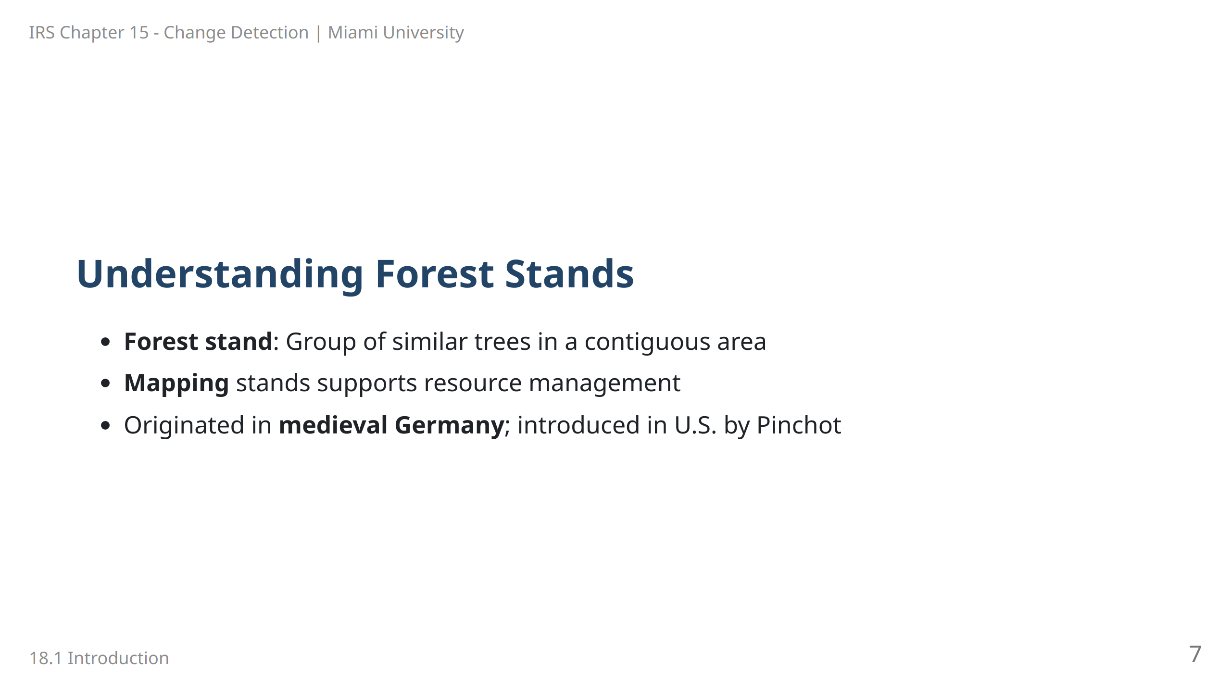
Notes:
Speaker Notes: Forest stands are groups of trees with similar characteristics, making them fundamental units for management and decision-making. The practice of mapping forest stands dates back to medieval Europe and was brought to the United States by Gifford Pinchot.

Slide 8
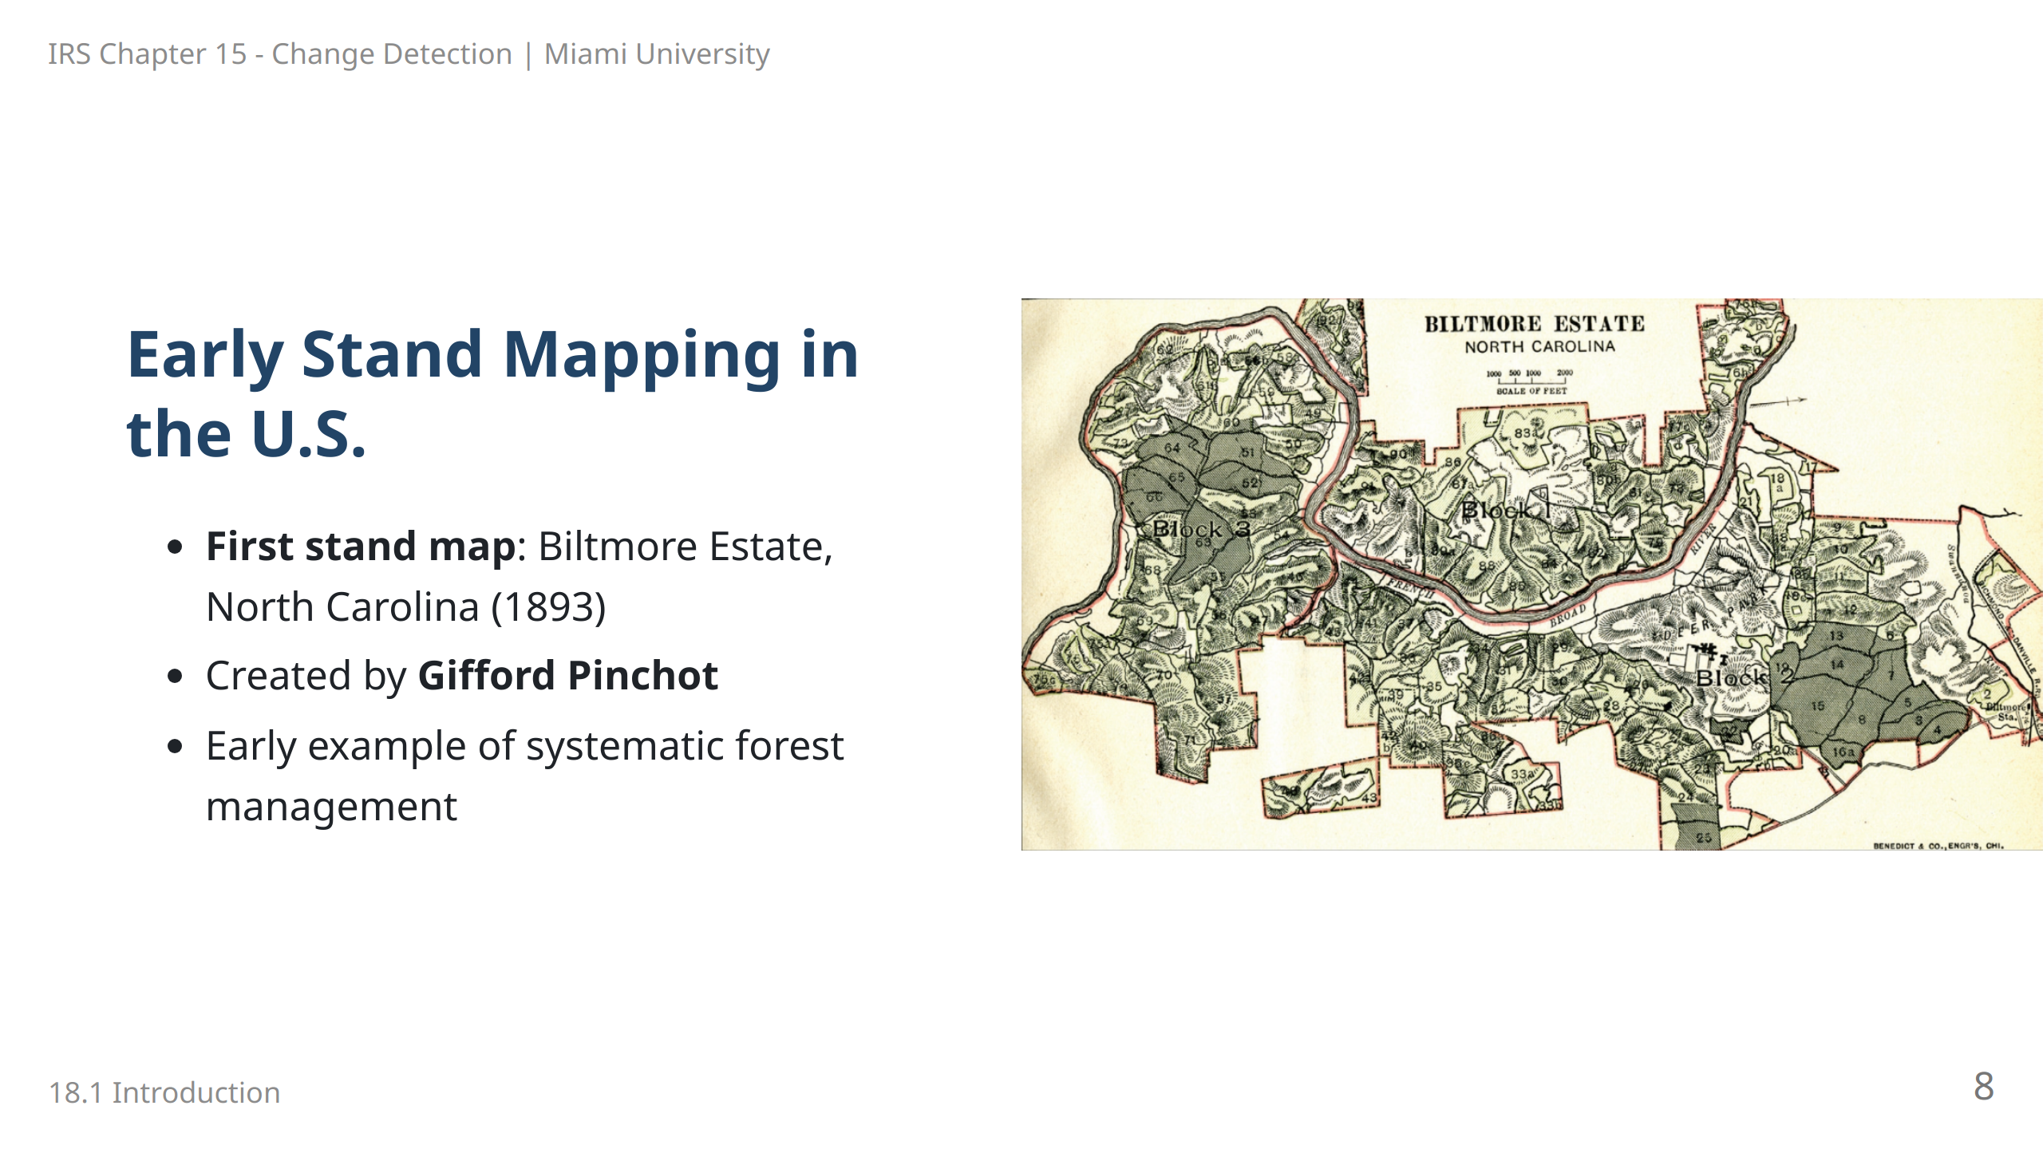
Notes:
Speaker Notes: The first stand map in the United States was created by Gifford Pinchot at the Biltmore Estate. This marked the beginning of systematic forest management, setting a precedent for future forest mapping and conservation.

Slide 9
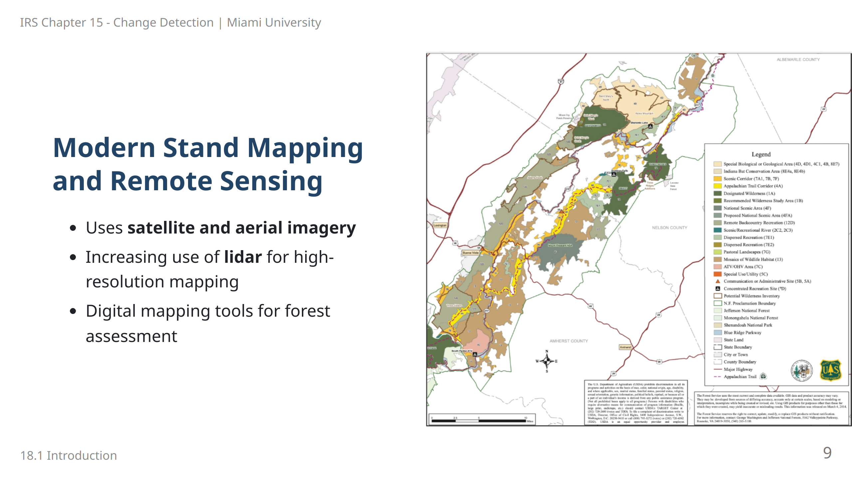
Notes:
Speaker Notes: Modern stand mapping employs remote sensing technology, including satellite images and lidar, to assess forest stands accurately. These tools allow for detailed, digital representations of forest resources, essential for sustainable management.

Slide 10
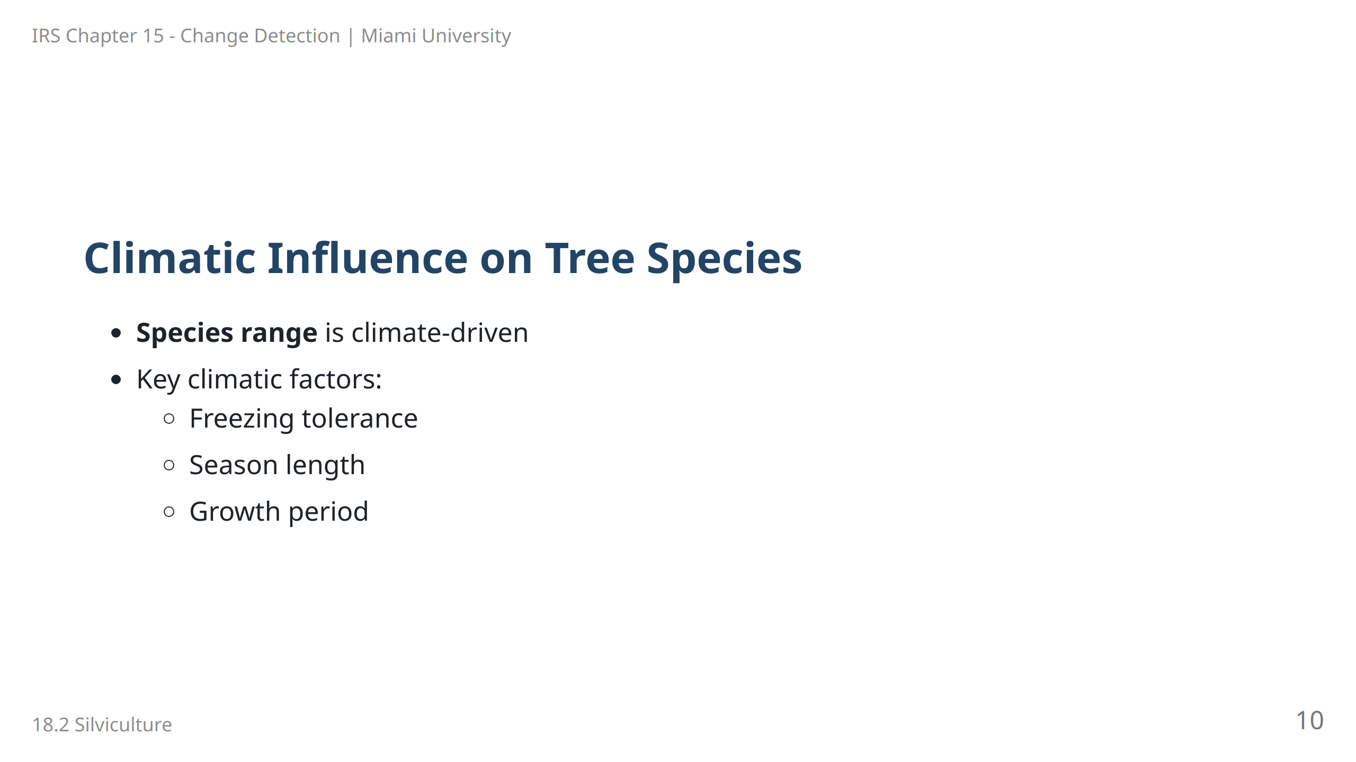
Notes:
Speaker Notes: Tree species distribution is largely determined by climate. Factors like freezing tolerance, season length, and growth period play a major role in defining where a species can thrive, influencing forestry practices.

Slide 11
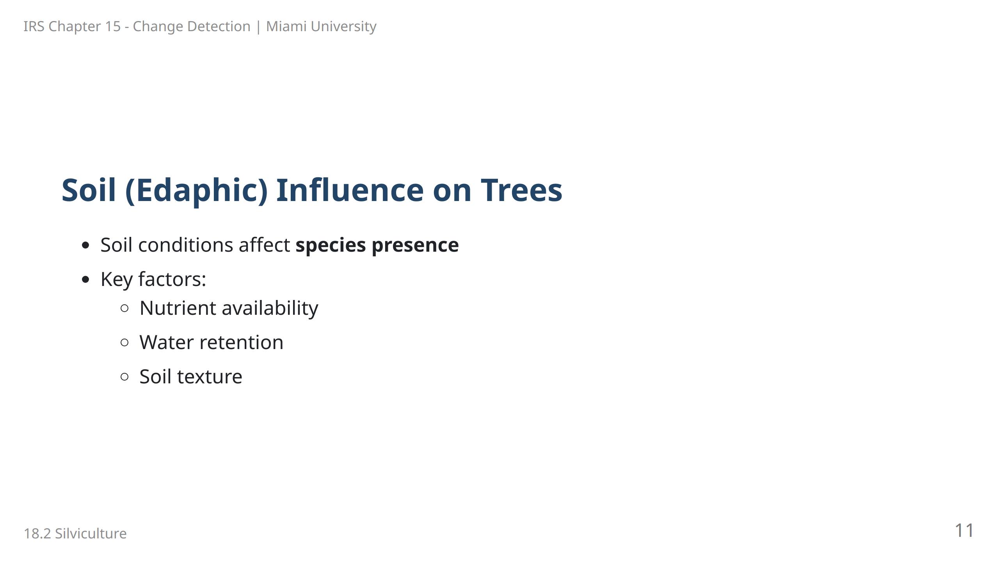
Notes:
Speaker Notes: Soil properties, also known as edaphic factors, influence whether a particular tree species will grow in a given location. Forestry must consider these factors, such as nutrient and water availability, to determine species suitability.

Slide 12
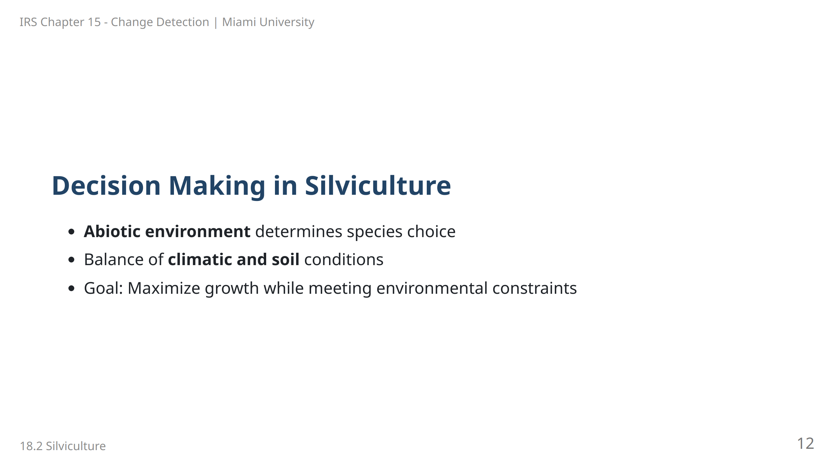
Notes:
Speaker Notes: In silviculture, selecting the right species for planting involves balancing both climatic and soil conditions. The objective is to choose species that will thrive and fulfill management goals within these environmental constraints.

Slide 13
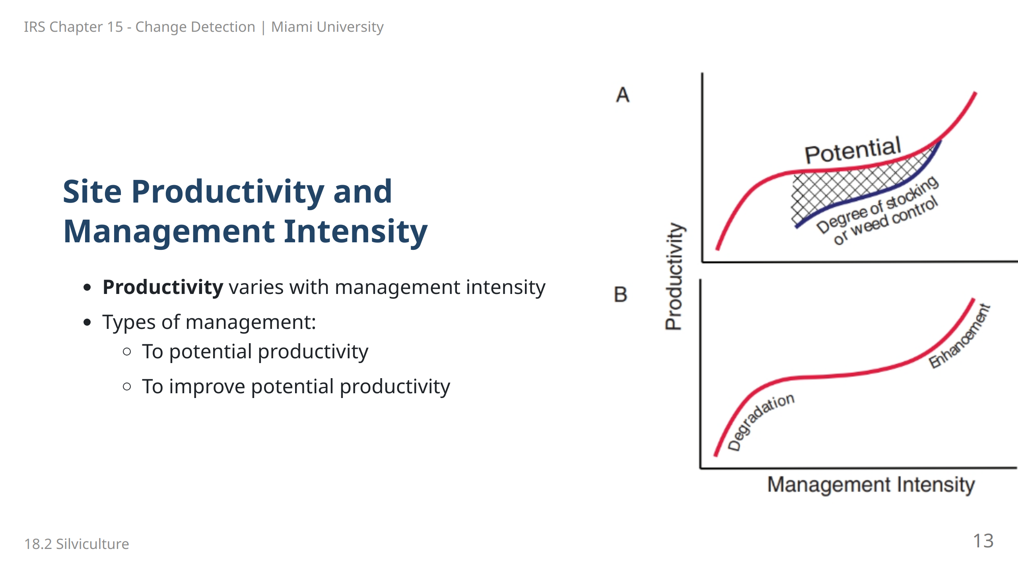
Notes:
Speaker Notes: Management intensity impacts site productivity. Forestry practices can aim to either reach the natural productivity of a site or actively enhance productivity through interventions.

Slide 14
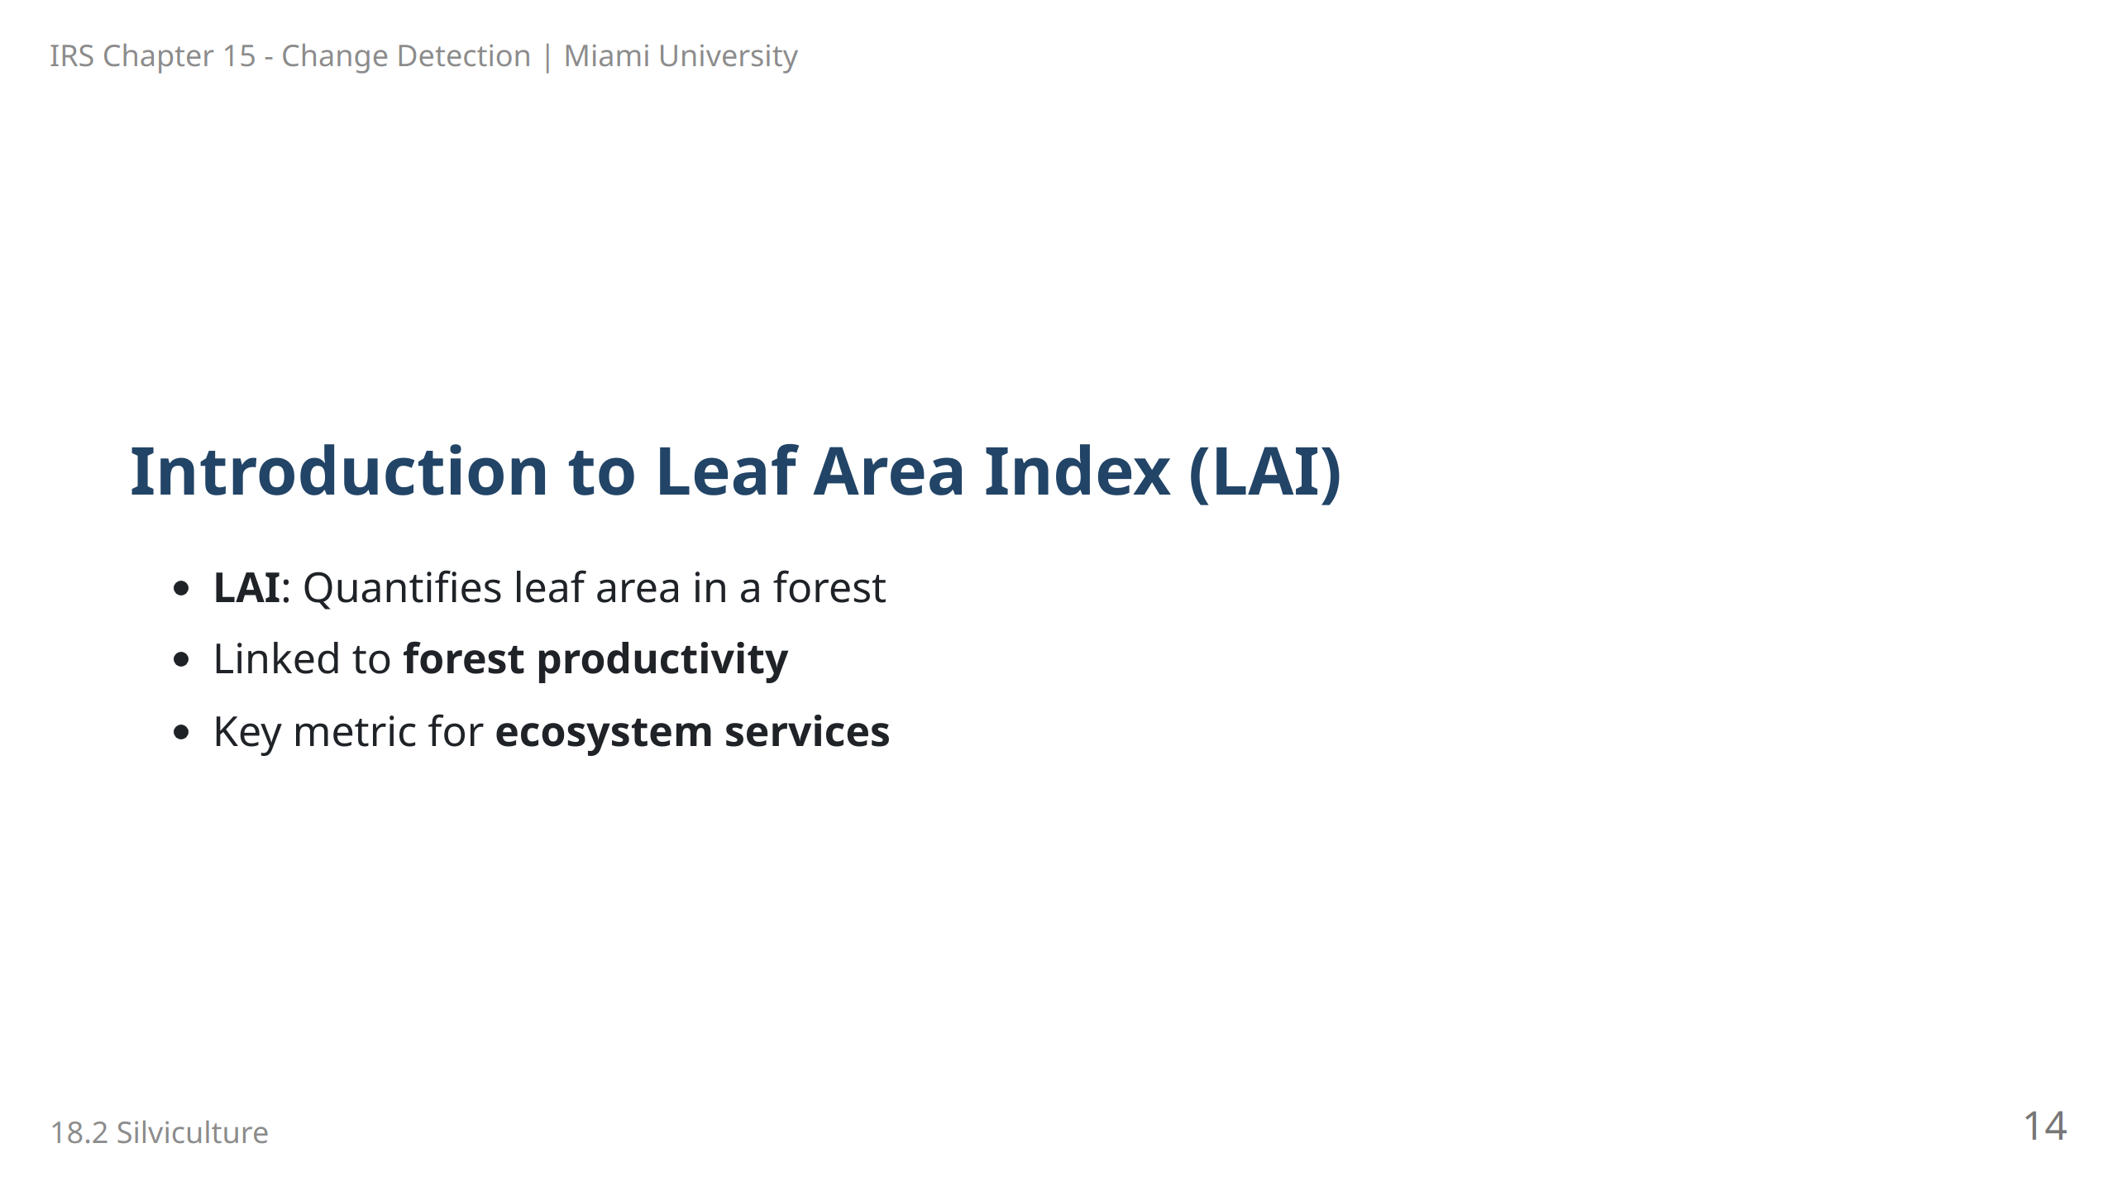
Notes:
Speaker Notes: Leaf Area Index (LAI) measures the leaf area within a given ground area, a critical indicator of forest productivity and health. Higher LAI often correlates with greater ecosystem benefits, including carbon storage and habitat provision.

Slide 15
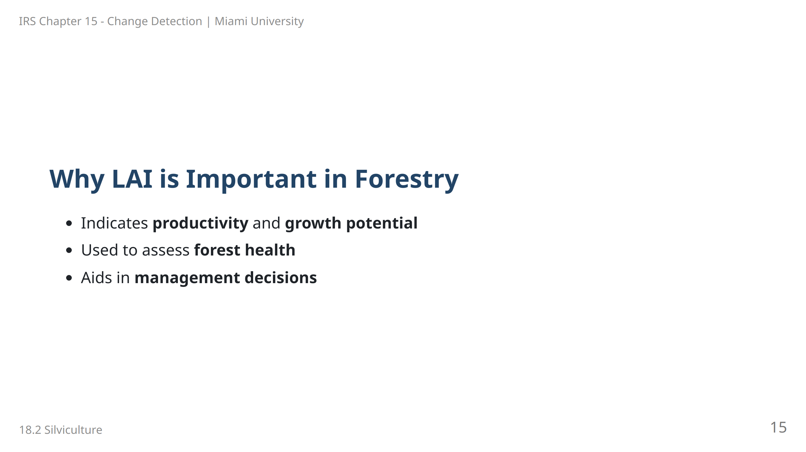
Notes:
Speaker Notes: LAI is a valuable metric in forestry as it provides insight into a forest's productivity and health. By measuring leaf area, foresters can make informed decisions regarding management and conservation strategies.

Slide 16
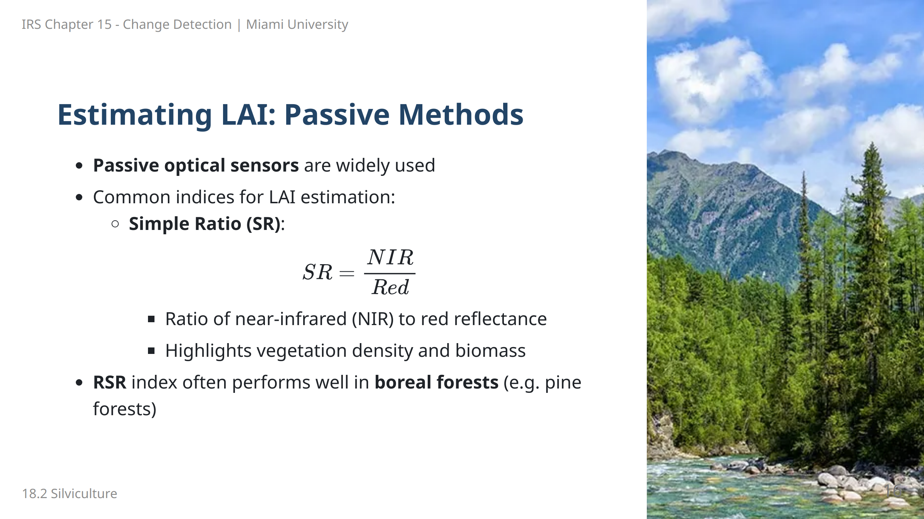
Notes:
Speaker Notes: Passive optical sensors use indices to estimate Leaf Area Index (LAI), an important indicator of forest productivity. Simple Ratio (SR) compares NIR to red reflectance, with higher values typically indicating denser vegetation. It serves as a reliable indicator of biomass and canopy density, useful for assessing vegetation structure.

Slide 17
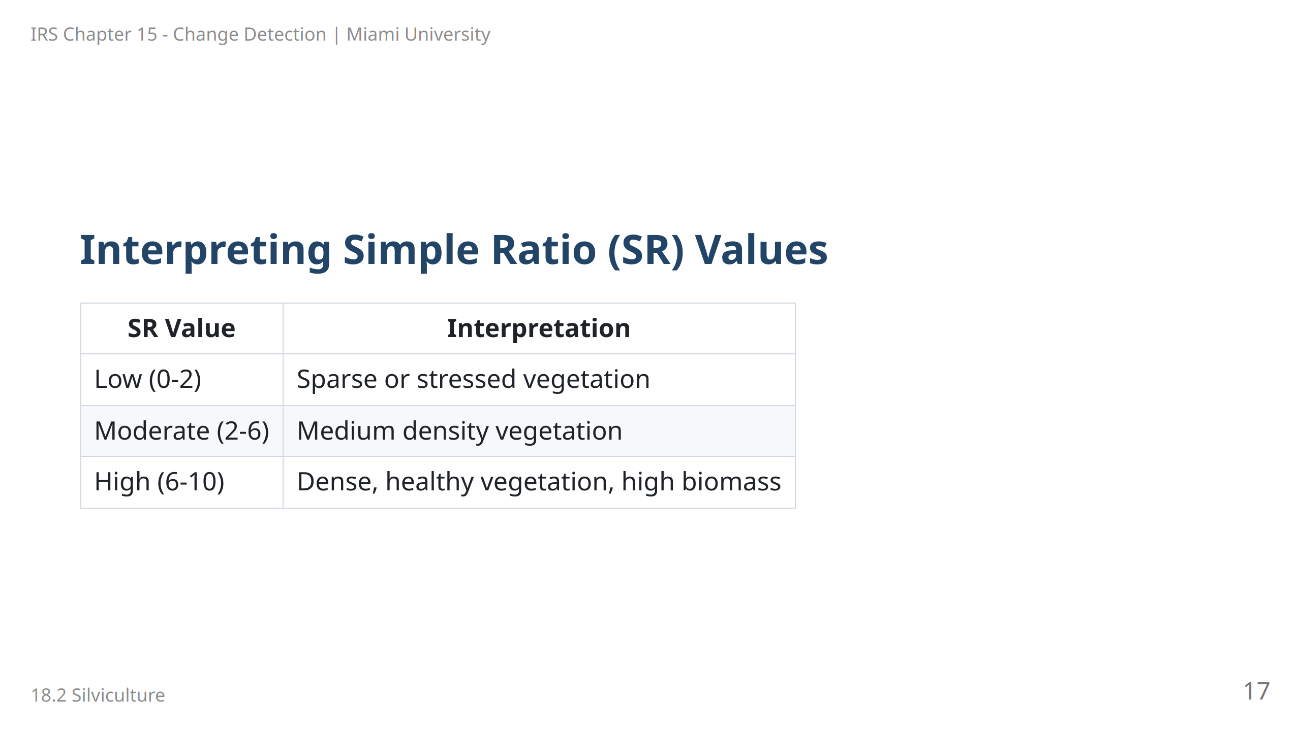
Notes:
Speaker Notes: The Simple Ratio (SR) uses the ratio of near-infrared to red reflectance to indicate vegetation density: - Low SR values suggest sparse or stressed vegetation. - Moderate values indicate a medium vegetation density. - High SR values correlate with dense, healthy vegetation, often with a high biomass, as healthy vegetation reflects more NIR and absorbs more red light.

Slide 18
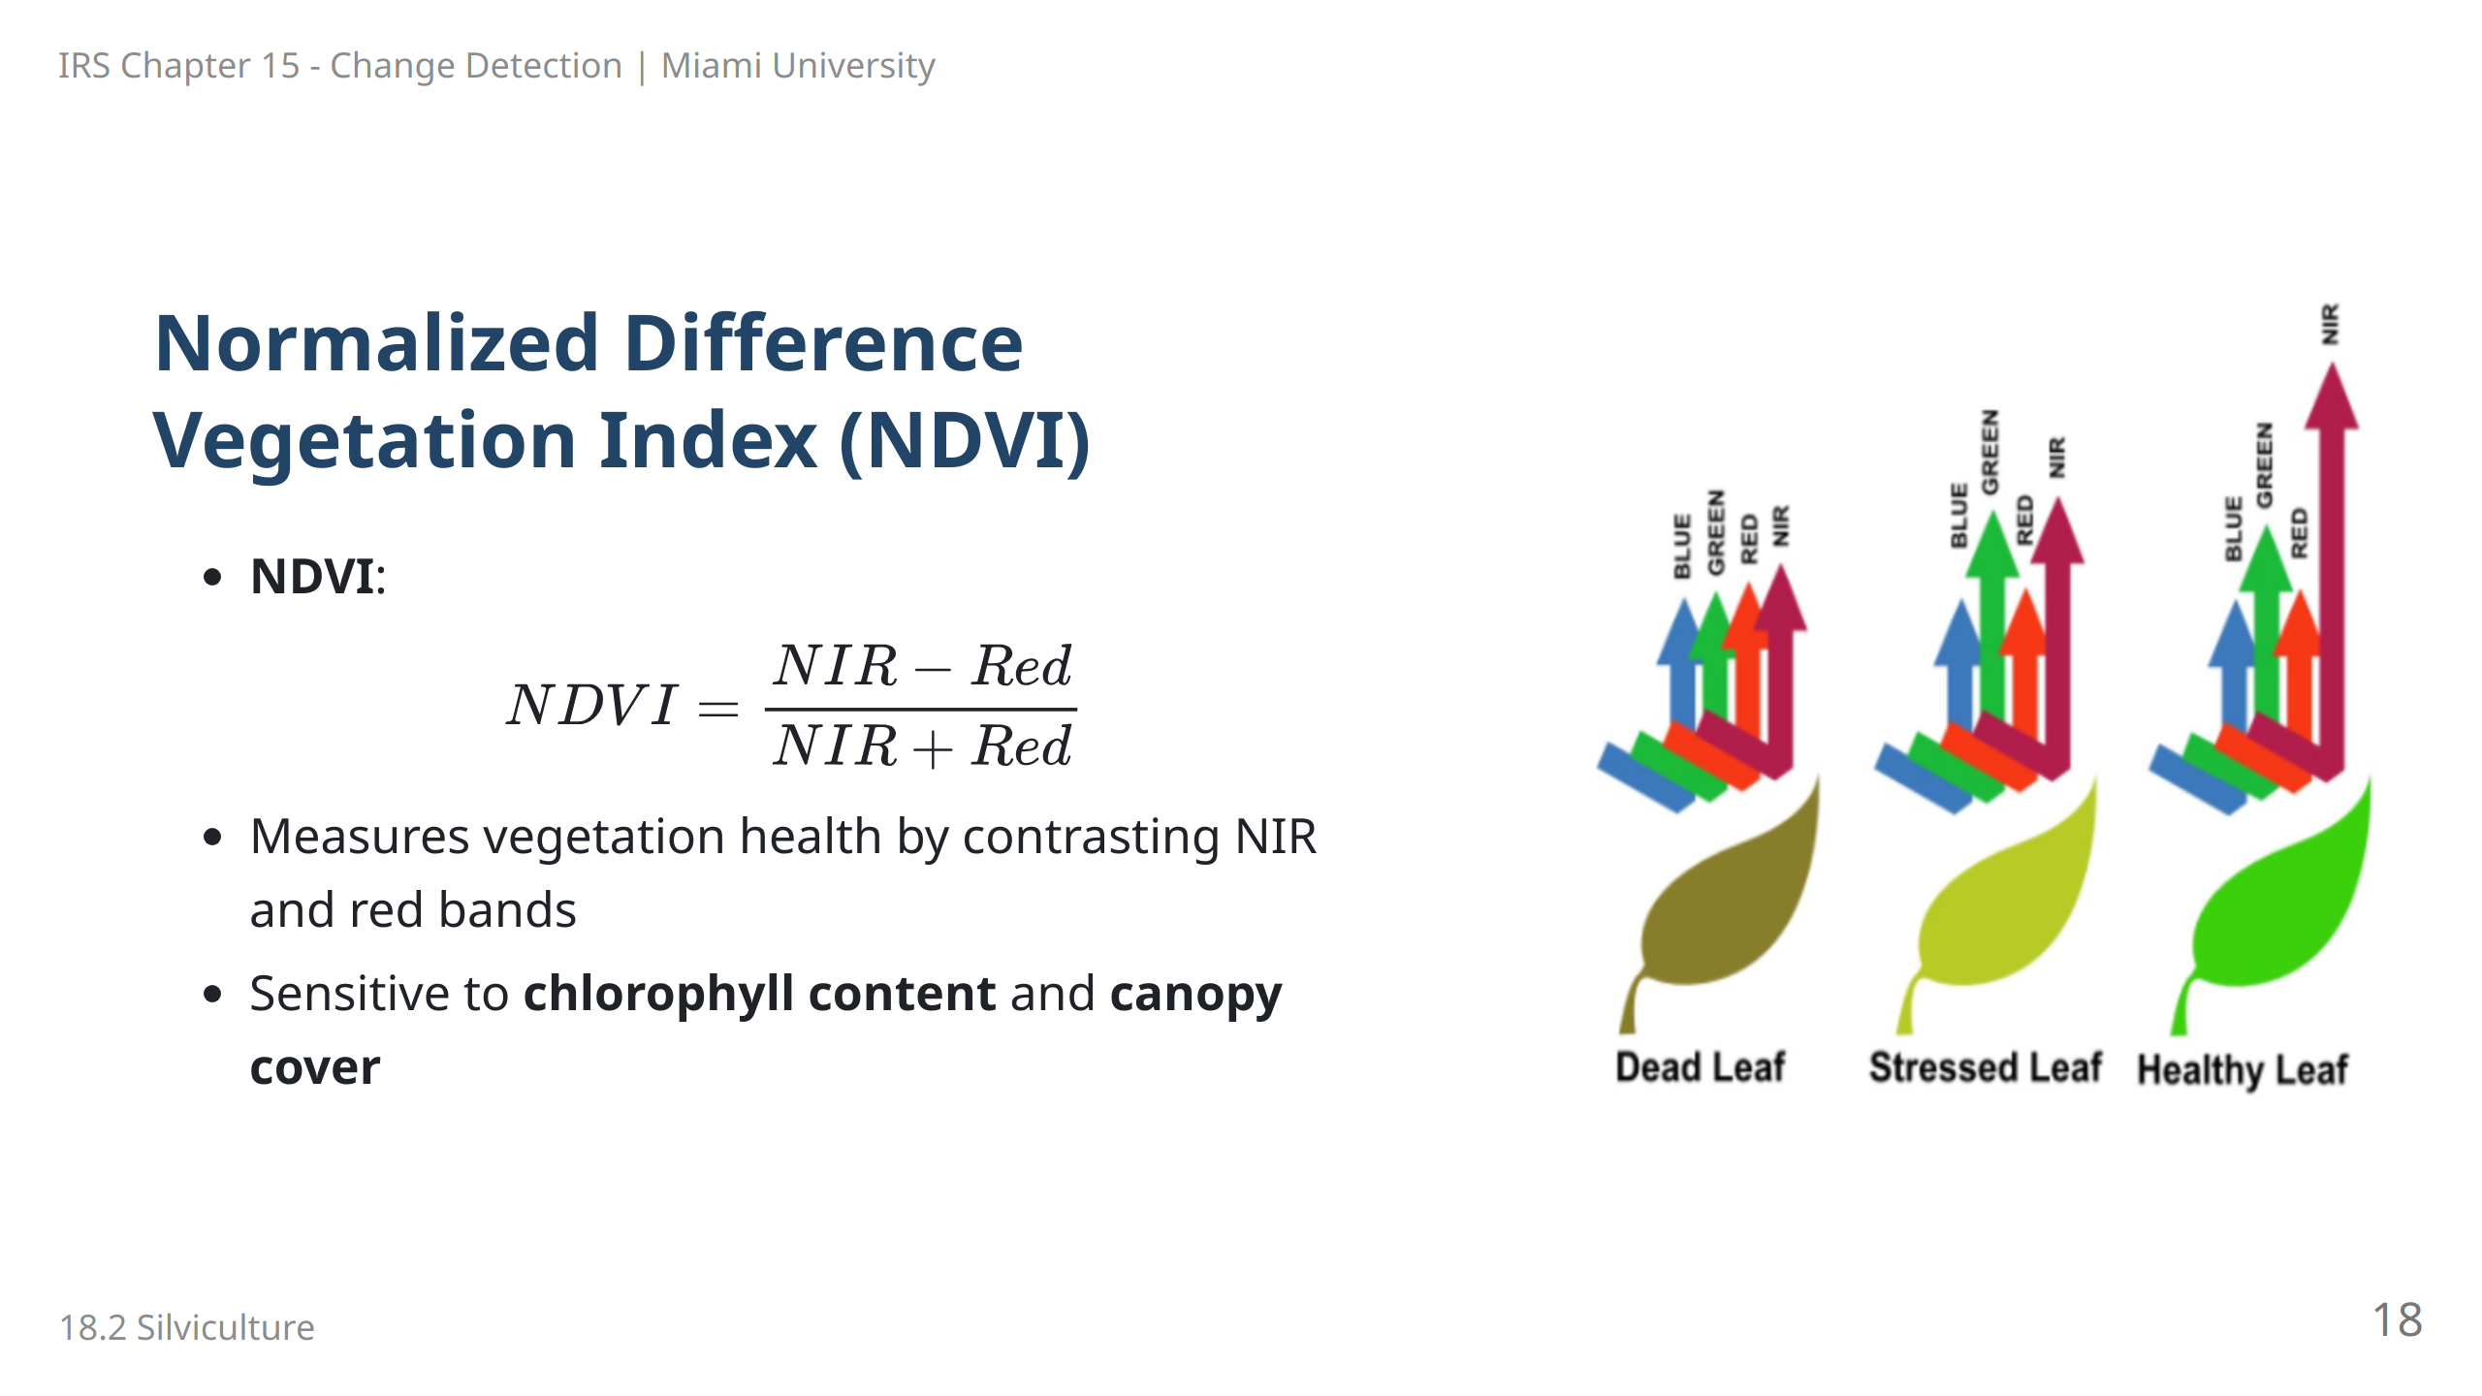
Notes:
![bg right:50% w:100%](images/image-16.png) Speaker Notes: NDVI is widely used for assessing vegetation health by contrasting NIR and red reflectance, where NIR is high in healthy vegetation, and red is absorbed by chlorophyll. NDVI values range from -1 to +1, with higher values indicating healthy, dense vegetation. It’s a robust indicator for vegetation vitality and LAI estimation across diverse forest types.

Slide 19
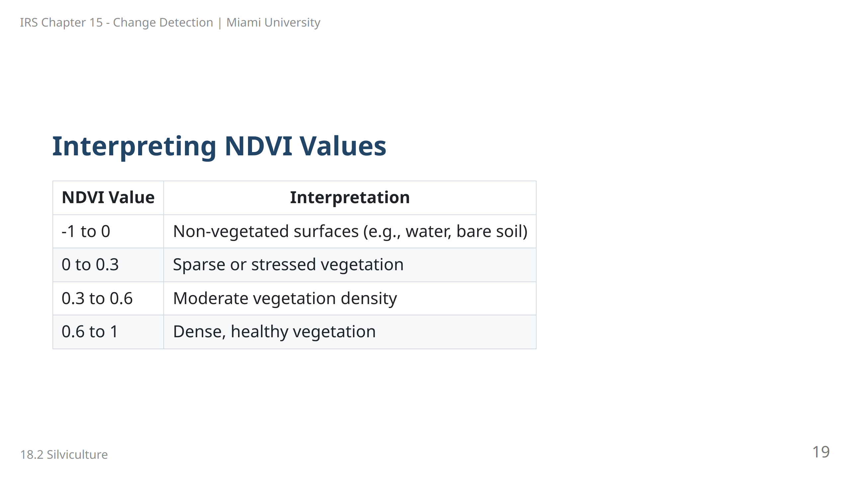
Notes:
Speaker Notes: NDVI values range from -1 to 1 and provide insights into vegetation health: - Values below 0 indicate non-vegetated surfaces, such as water or bare soil. - Low values (0 to 0.3) suggest sparse or stressed vegetation. - Moderate values (0.3 to 0.6) indicate moderate vegetation density. - High values (0.6 to 1) signify dense, healthy vegetation, ideal for productive ecosystems.

Slide 20
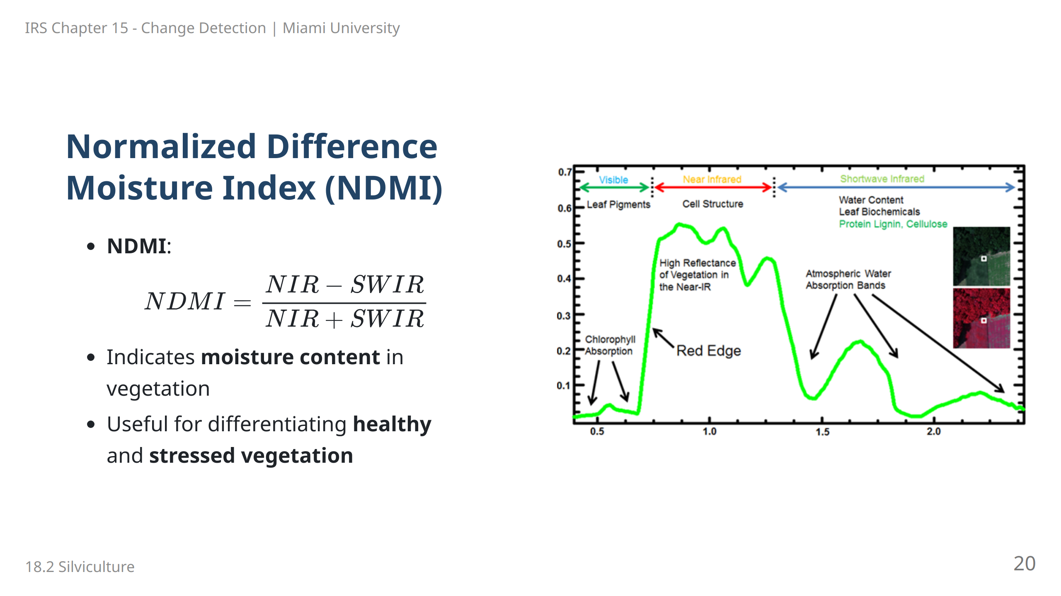
Notes:
Speaker Notes: NDMI contrasts NIR with SWIR reflectance, with SWIR being sensitive to water content in vegetation. This makes NDMI valuable for assessing moisture levels, helping to differentiate between healthy and stressed vegetation. It is particularly useful for LAI estimation in areas where water availability impacts vegetation health.

Slide 21
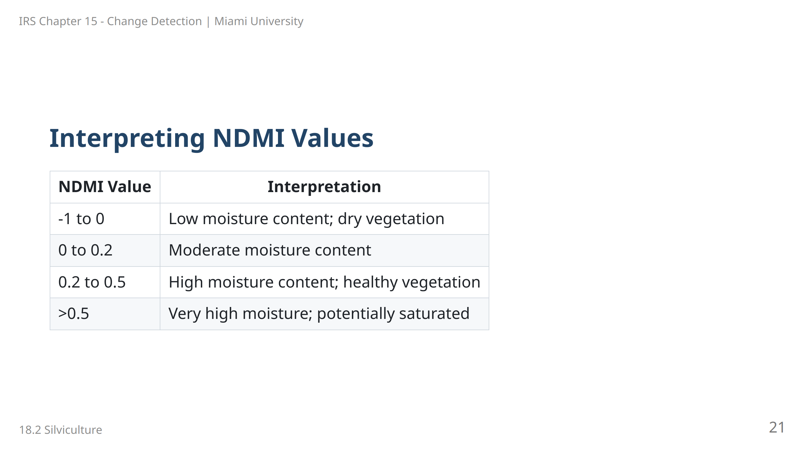
Notes:
Speaker Notes: NDMI values range from -1 to above 0.5, indicating moisture levels in vegetation: - Negative to zero values suggest dry or stressed vegetation. - Values between 0 and 0.2 indicate moderate moisture content. - Higher values (0.2 to 0.5) represent healthy, moist vegetation. - Values above 0.5 may indicate very high moisture levels, such as recently irrigated or rain-soaked vegetation.

Slide 22
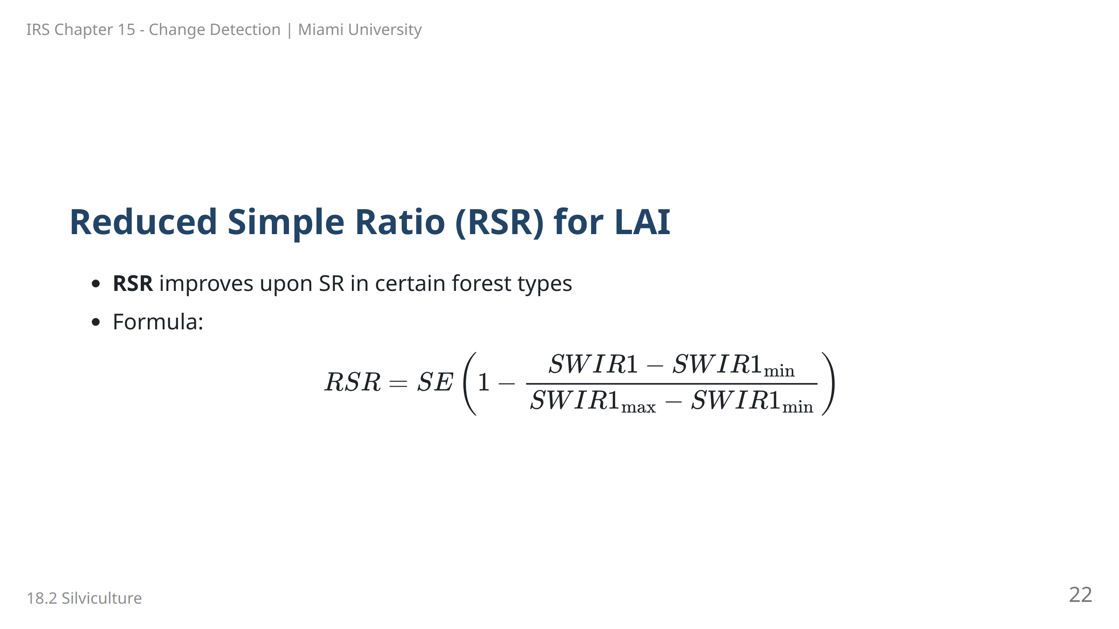
Notes:
Speaker Notes: The Reduced Simple Ratio (RSR) is an index designed to estimate LAI by using shortwave infrared (SWIR) data. This formula adjusts the SWIR reflectance values, providing a more robust measure of LAI in specific forest types.

Slide 23
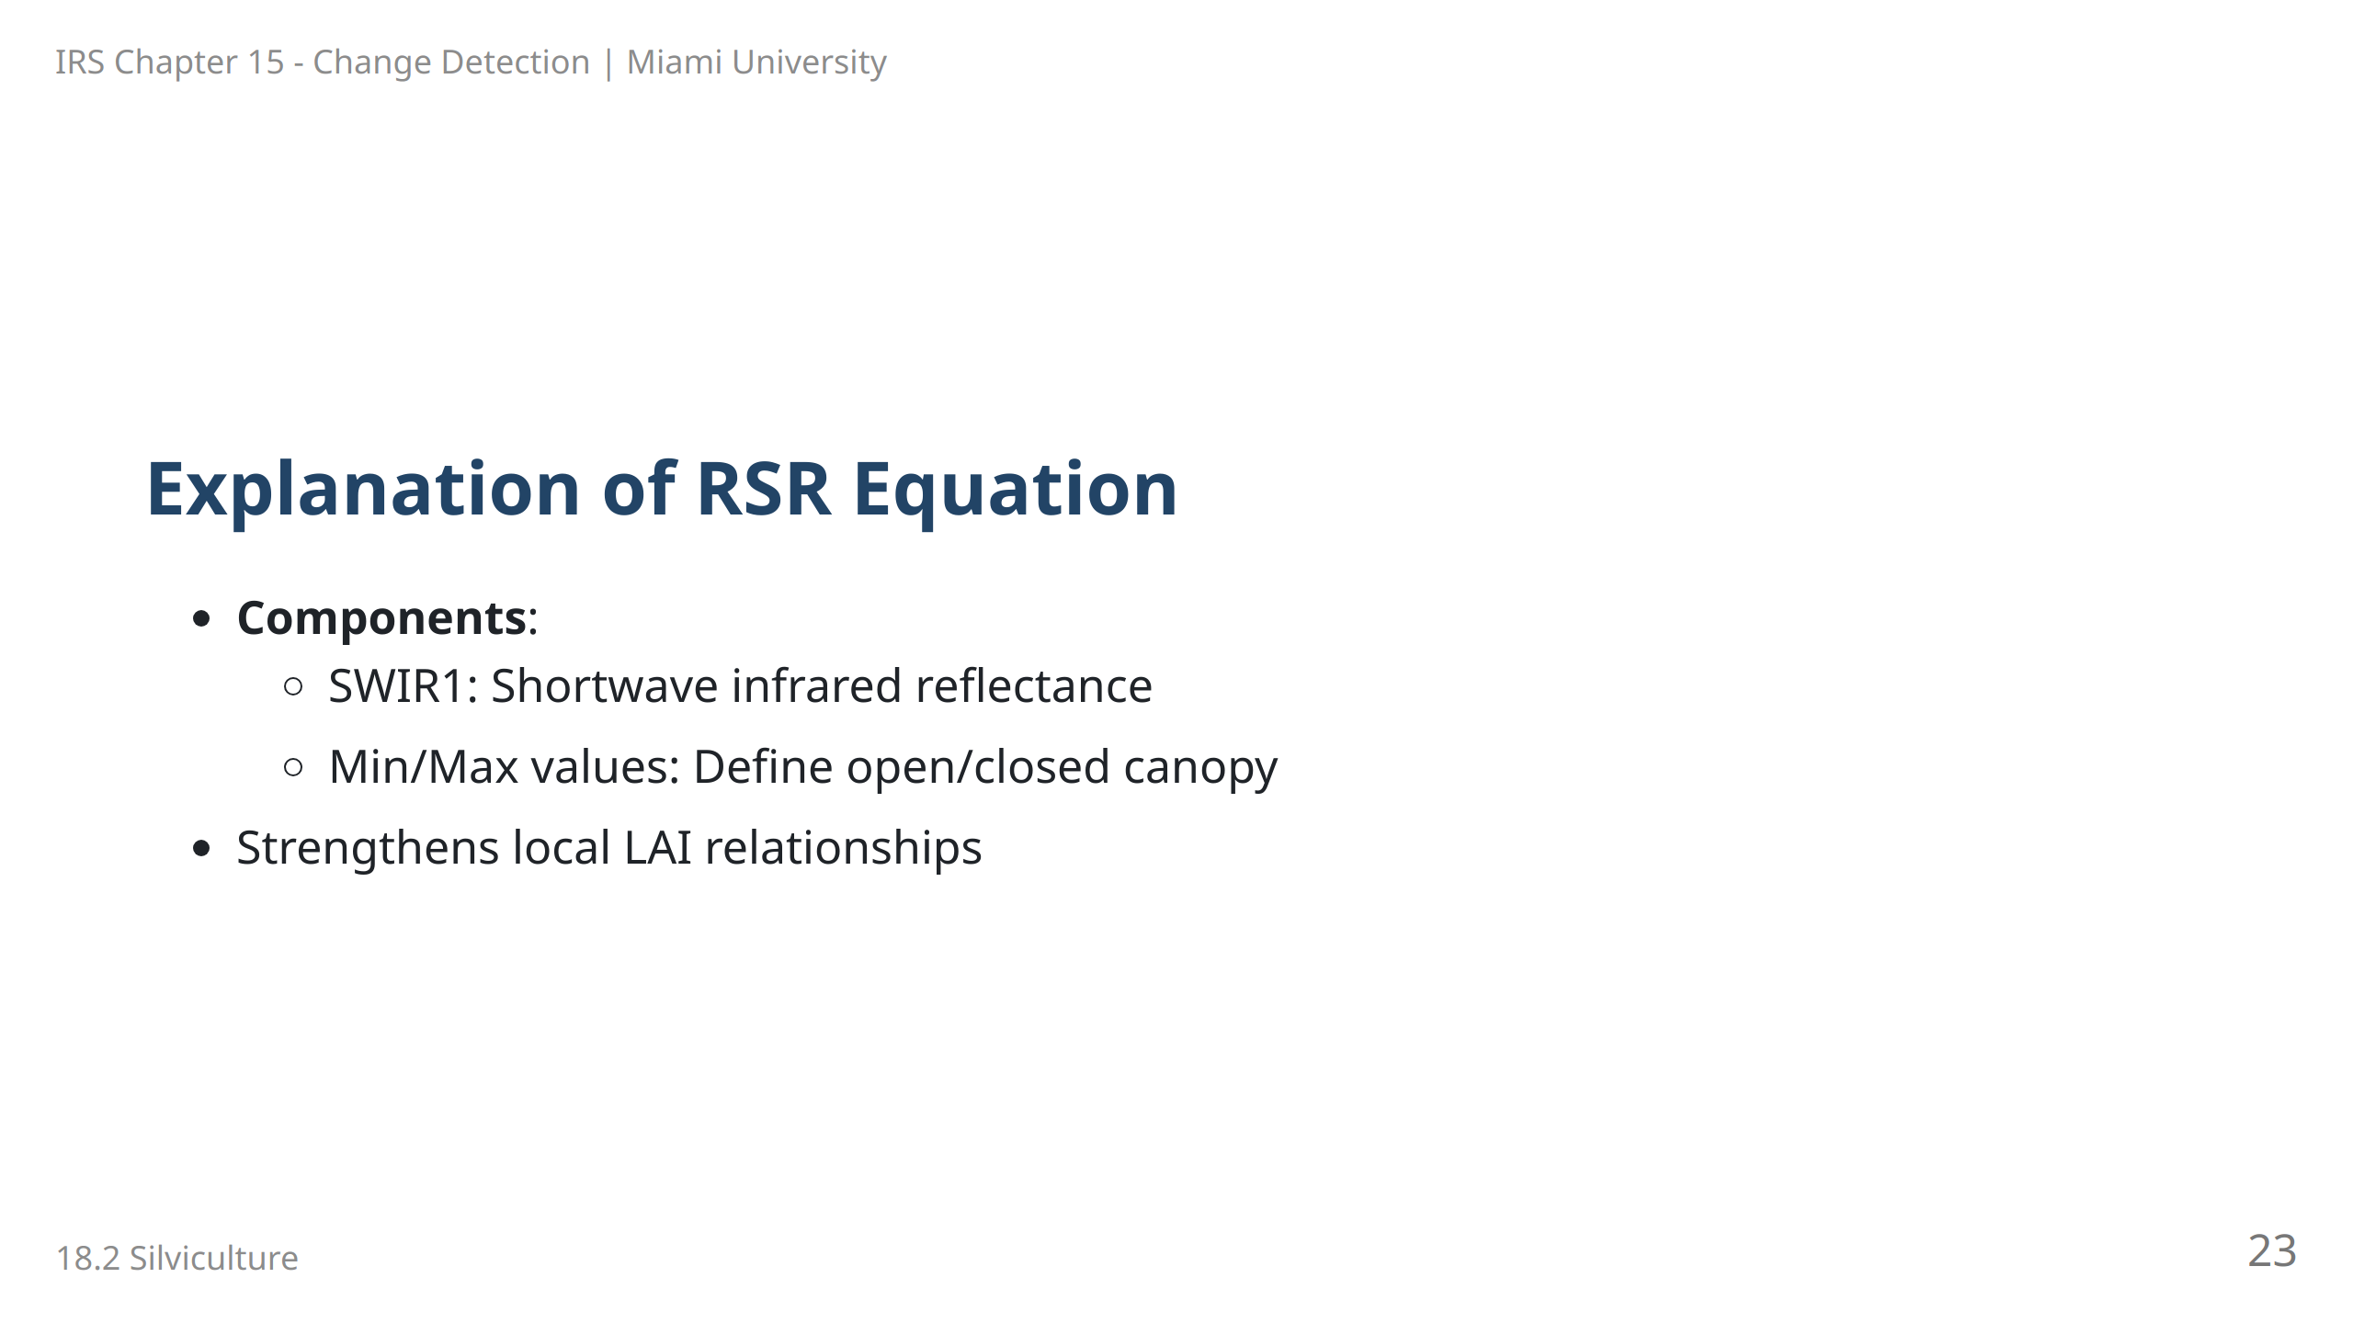
Notes:
Speaker Notes: This slide breaks down the RSR formula components. SWIR1 represents the shortwave infrared reflectance, while the minimum and maximum values refer to canopy openness. RSR’s specificity helps accurately relate LAI to local forest conditions.

Slide 24
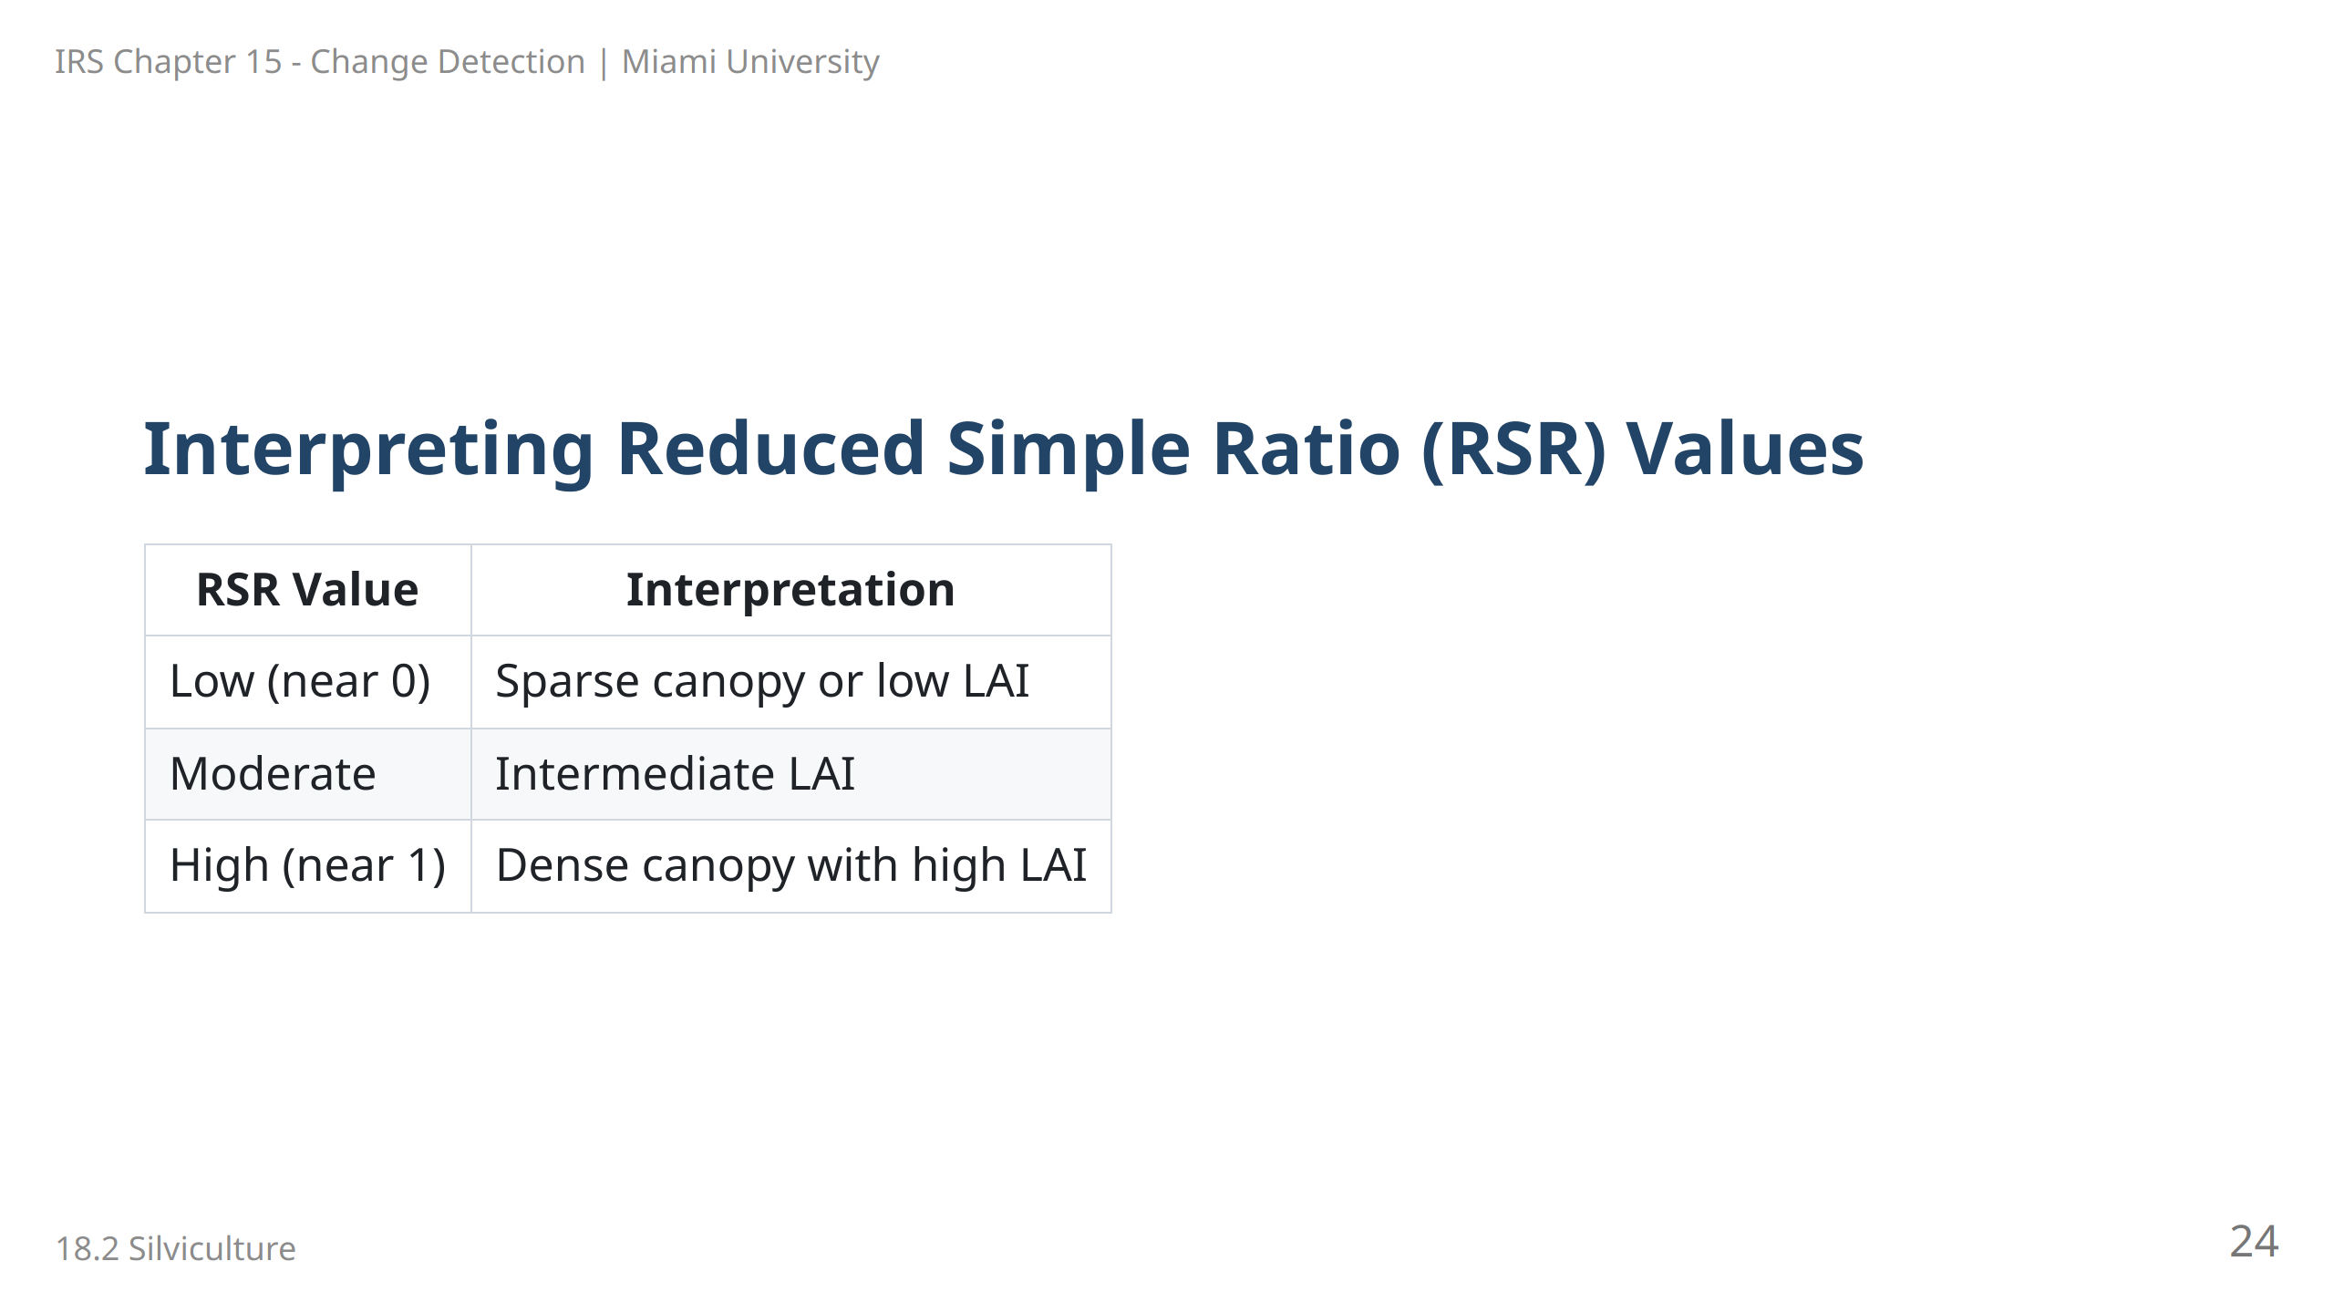
Notes:
Speaker Notes: The Reduced Simple Ratio (RSR) is an adaptation of the SR, specifically adjusted for canopy density: - Low RSR values correlate with sparse canopies or low LAI (Leaf Area Index). - Moderate values suggest an intermediate LAI, indicating a healthy but not fully dense canopy. - High RSR values are associated with dense, healthy canopies with high LAI, typically found in productive forest areas.

Slide 25
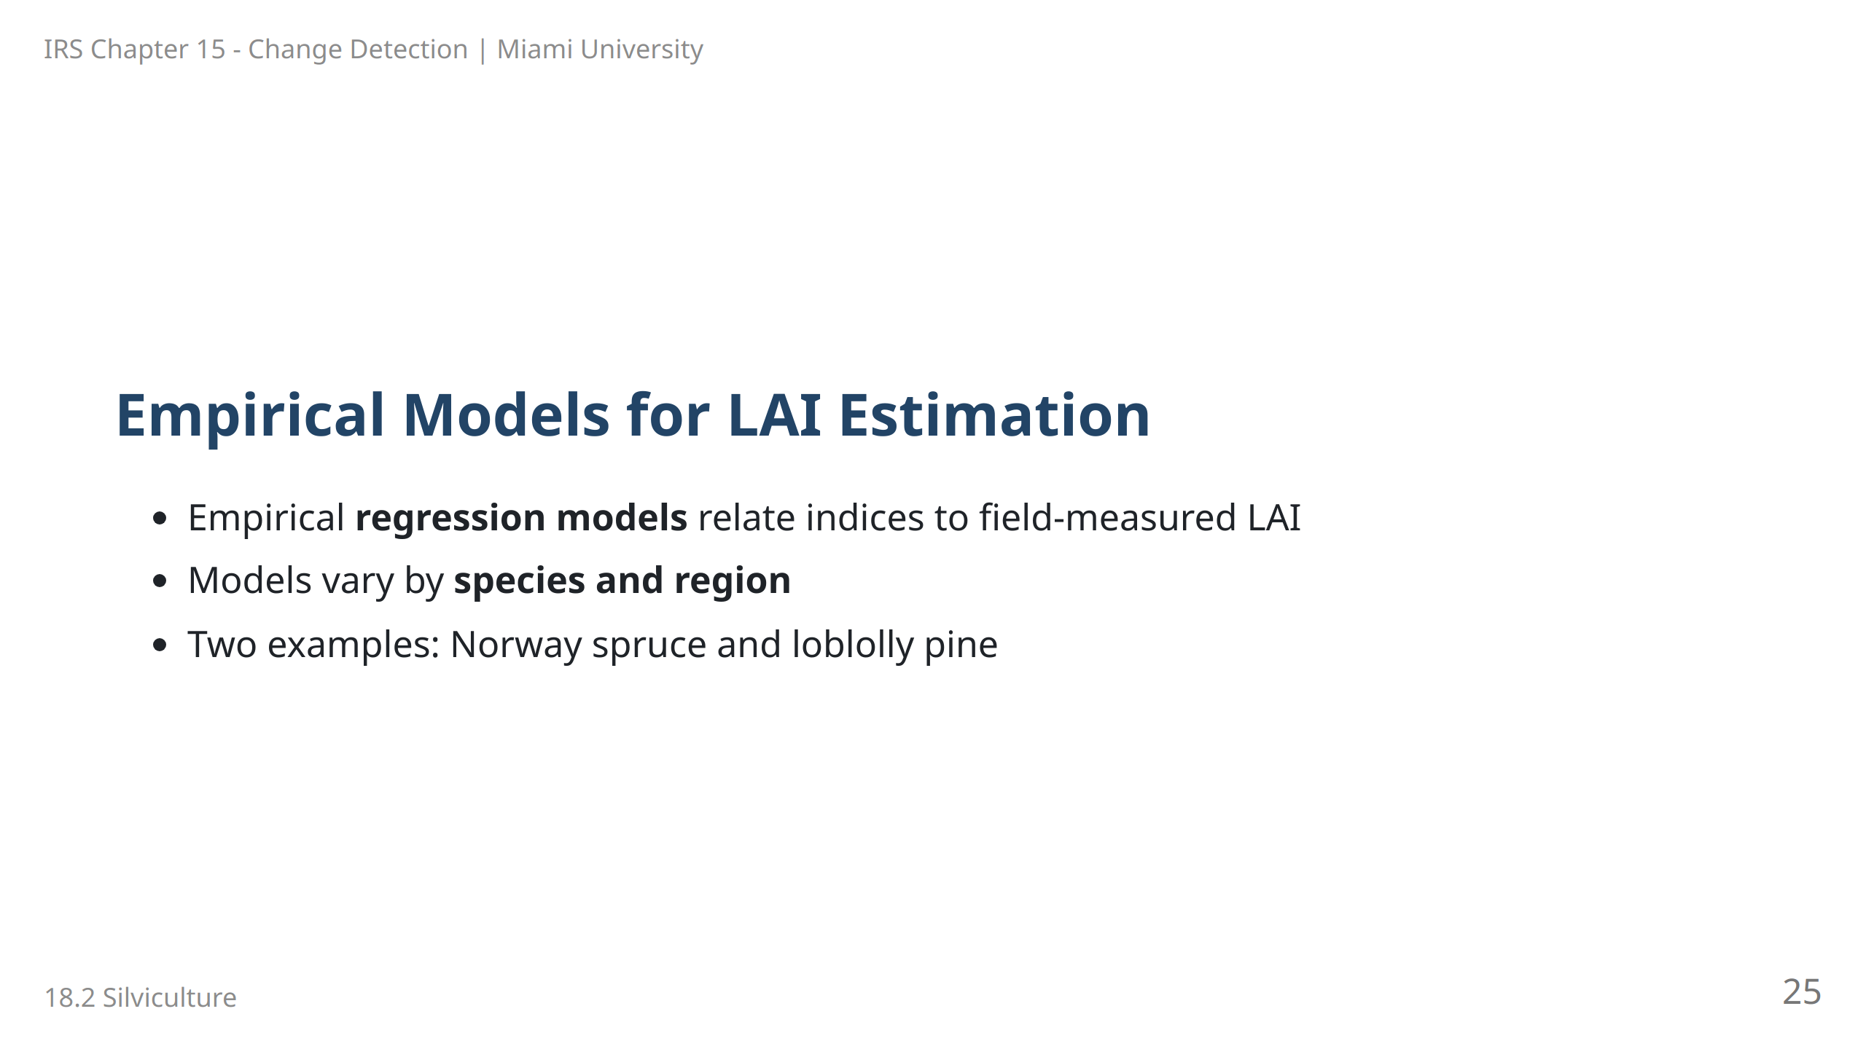
Notes:
Speaker Notes: Empirical models are commonly used to estimate LAI by correlating vegetation indices with field data. These models are typically region- and species-specific, ensuring accurate predictions for local forestry management.

Slide 26
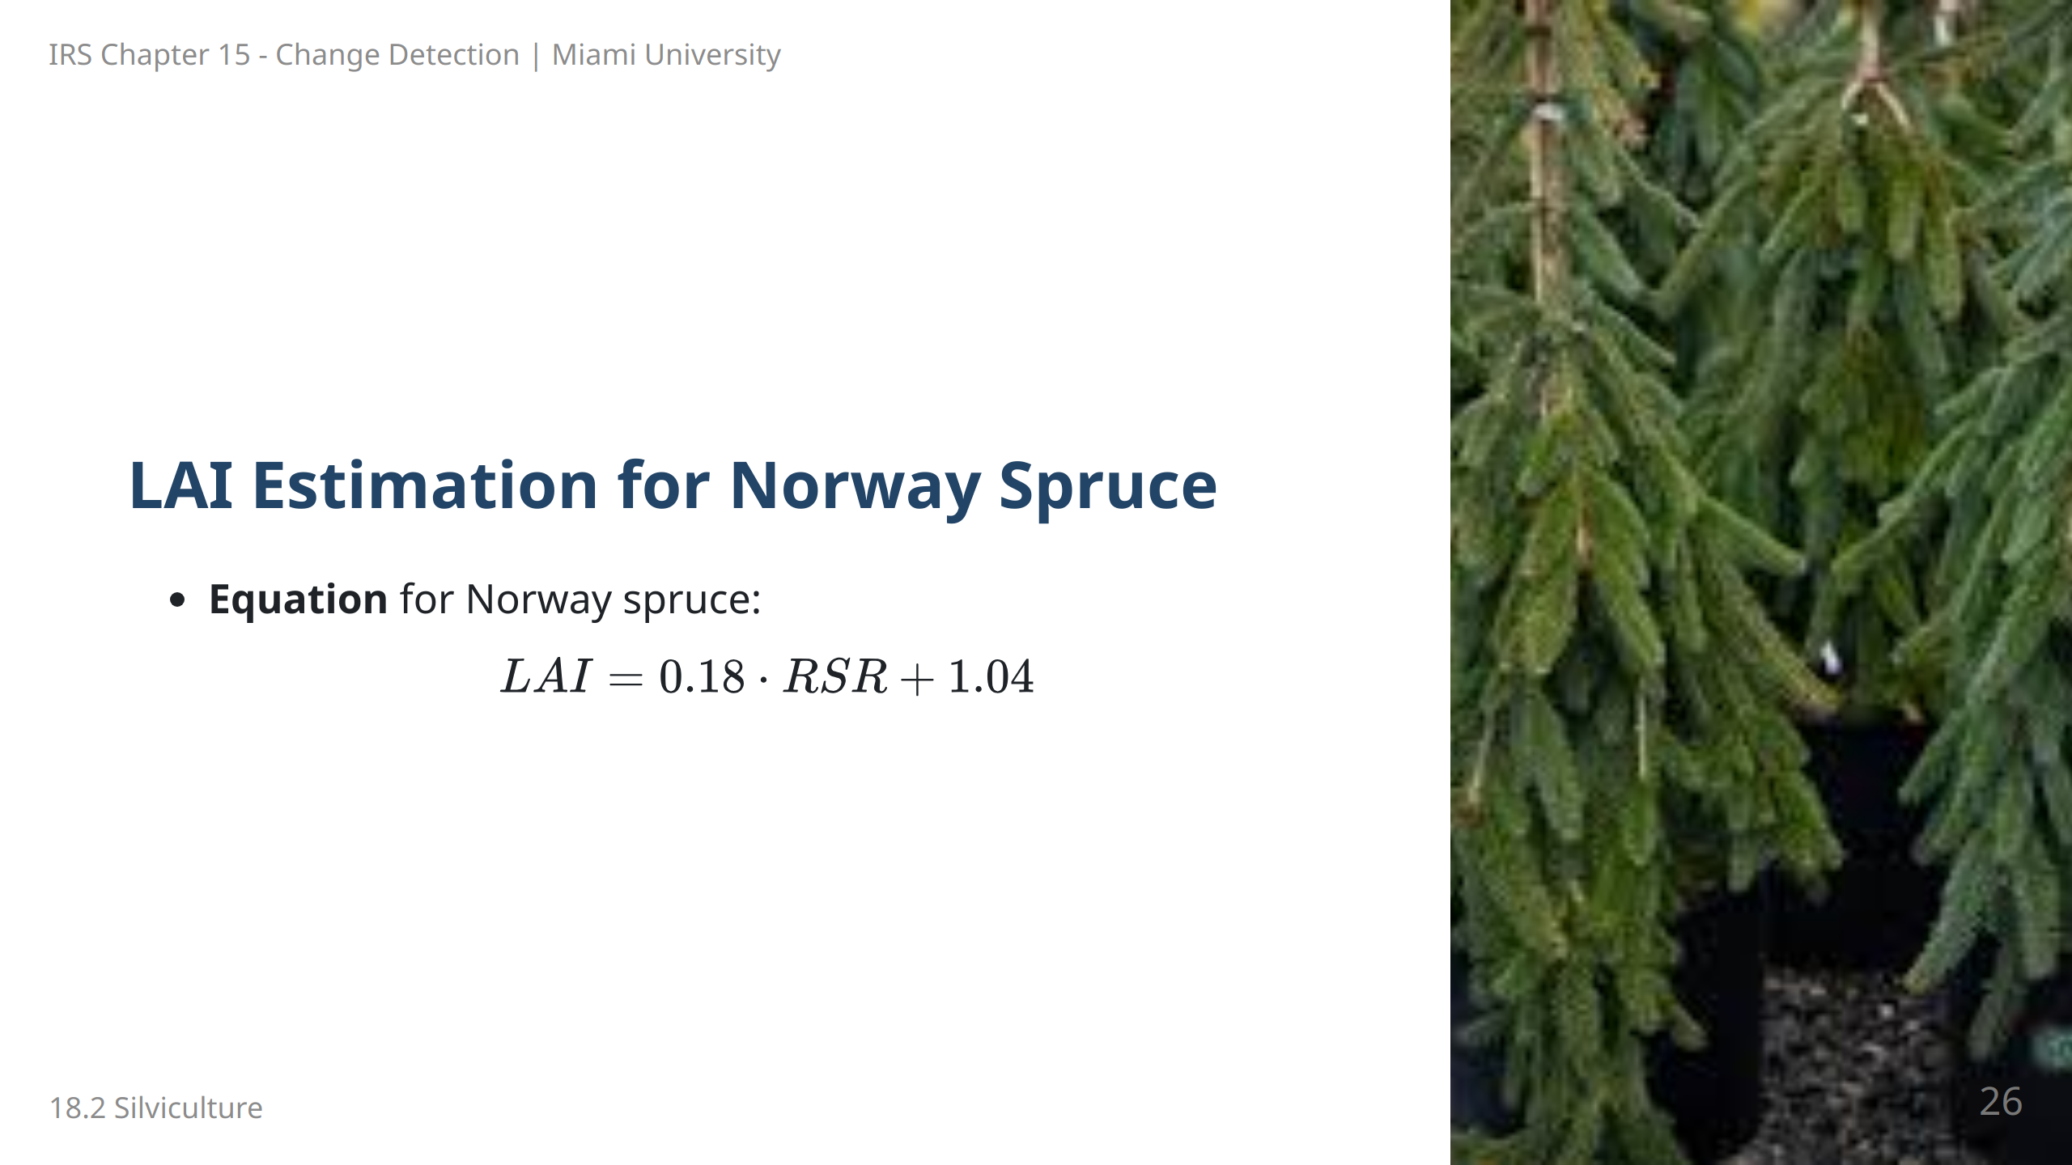
Notes:
Speaker Notes: This empirical model is specific to Norway spruce stands and uses the Reduced Simple Ratio (RSR) to predict LAI. The constant values are derived from regression analysis based on local forest data.

Slide 27
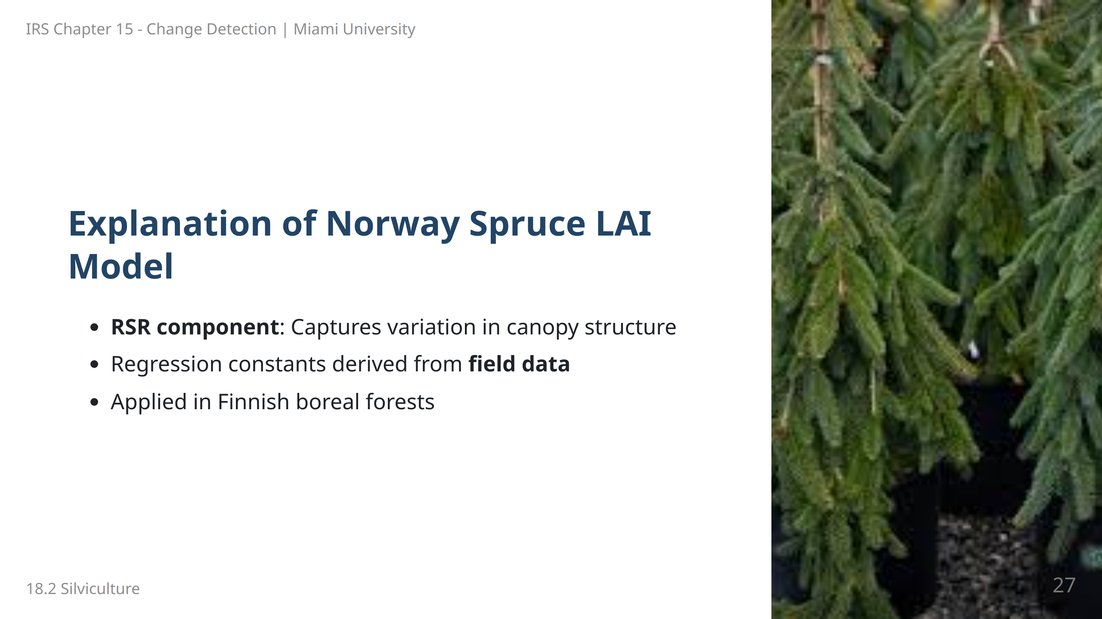
Notes:
Speaker Notes: The Norway spruce LAI model is derived from field data and regression analysis, allowing RSR to capture specific variations in canopy structure. This model is particularly applicable in boreal forests.

Slide 28
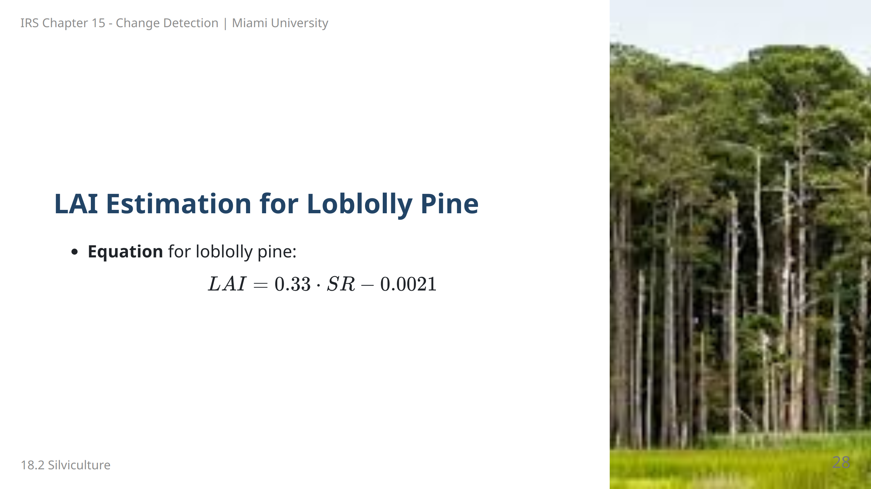
Notes:
Speaker Notes: This empirical model predicts LAI for loblolly pine stands using the Simple Ratio (SR). The constants in the equation are calibrated based on loblolly pine forests in the southeastern United States.

Slide 29
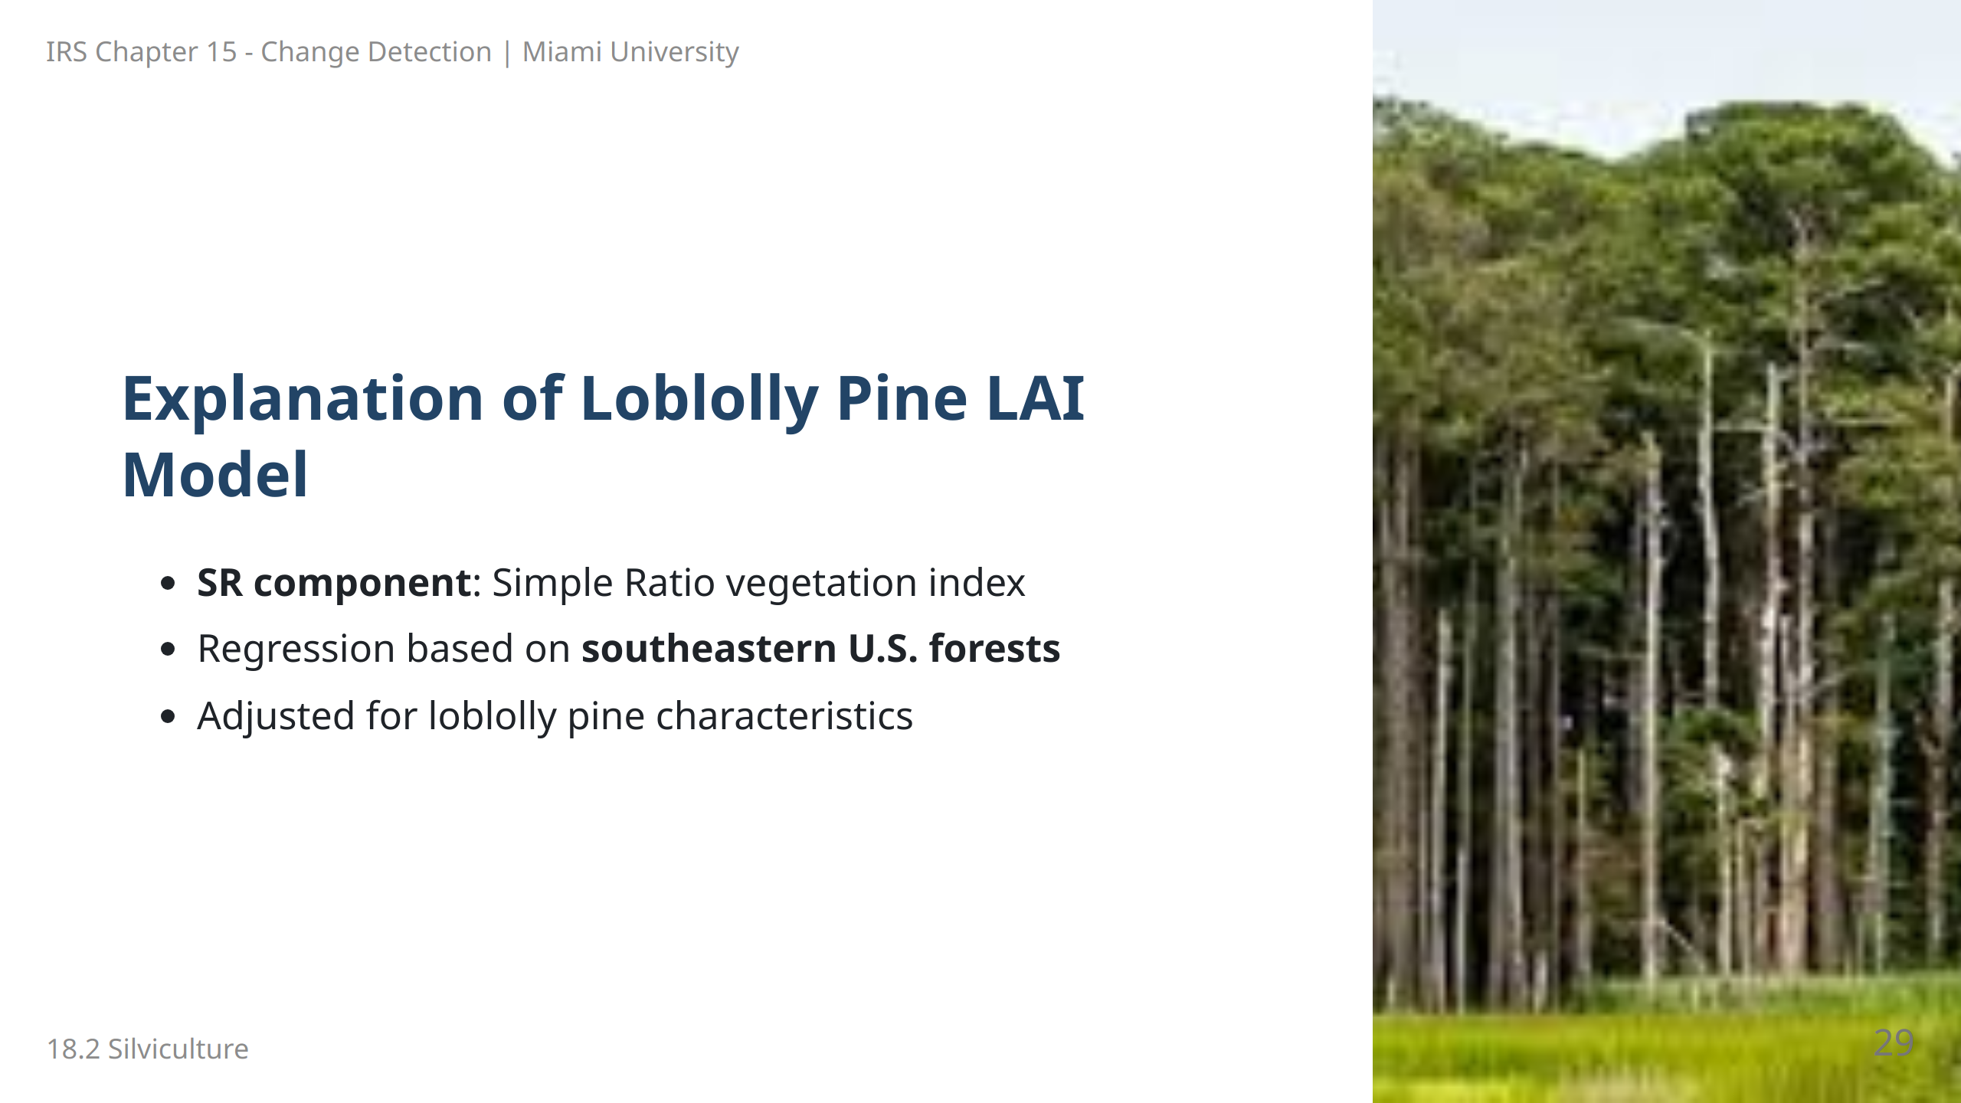
Notes:
Speaker Notes: The SR-based model for loblolly pine is specific to the southeastern United States. This slide explains how SR and the constants capture LAI variations within this tree species.

Slide 30
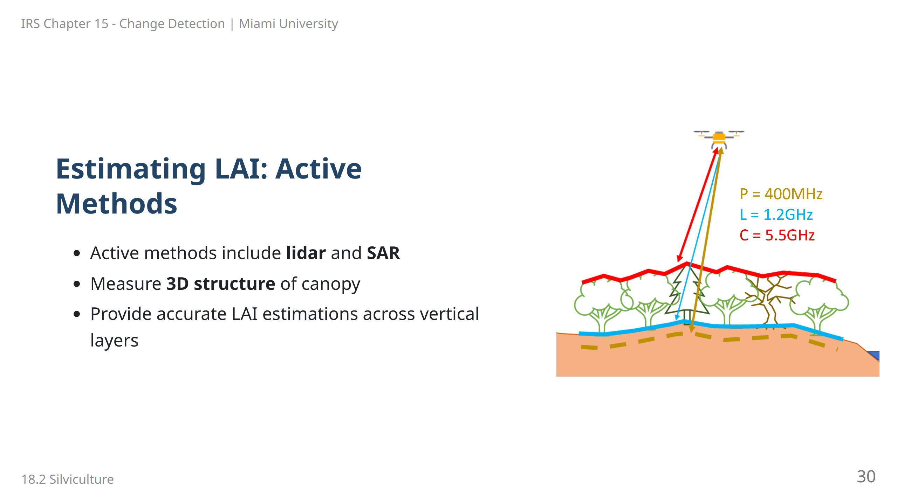
Notes:
Speaker Notes: Active methods, including lidar and synthetic aperture radar (SAR), allow for accurate estimation of LAI by capturing the 3D structure of forest canopies. These methods are valuable for layered forest assessments.

Slide 31
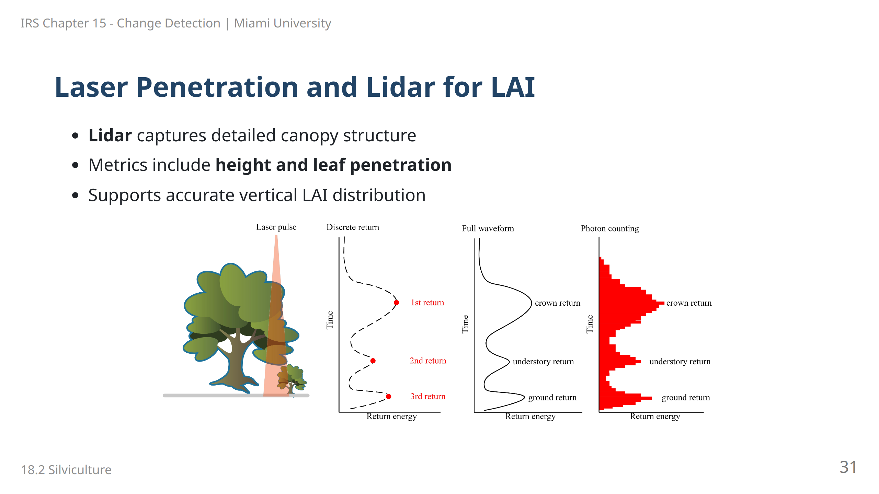
Notes:
Speaker Notes: Lidar technology offers a precise way to measure forest canopy structure, providing metrics on height, volume, and leaf penetration. This information supports detailed estimations of LAI, particularly in vertically stratified forests.

Slide 32
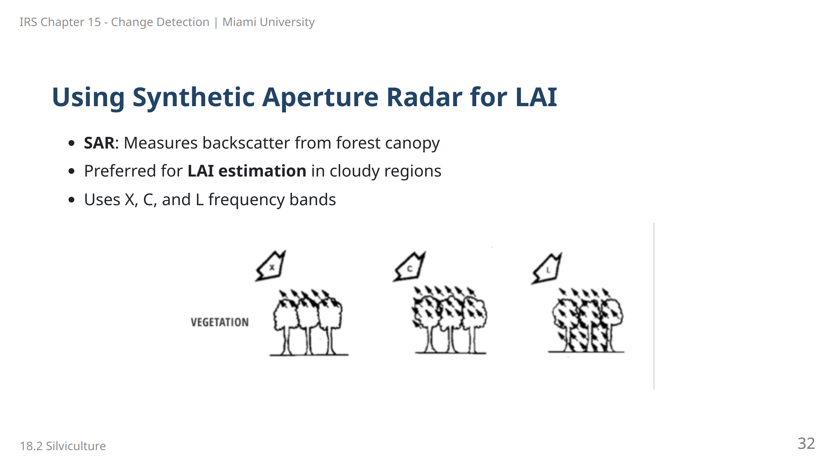
Notes:
![bg right:40% w:100%](images/image-3.png) Speaker Notes: Synthetic aperture radar (SAR) is effective for estimating LAI, particularly in areas with frequent cloud cover. SAR backscatter provides reliable data on canopy structure, which helps estimate LAI under various environmental conditions.

Slide 33
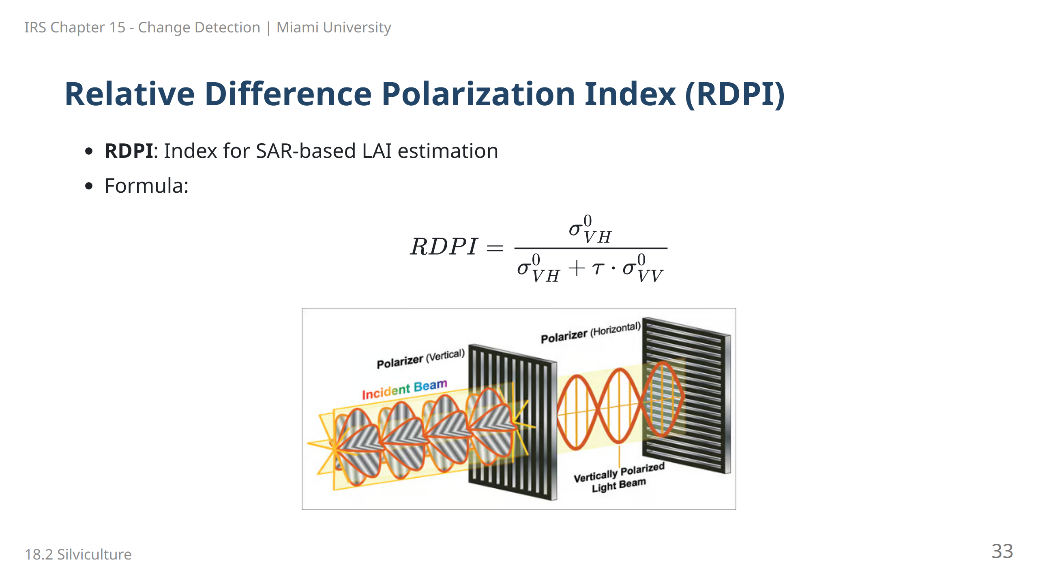
Notes:
Speaker Notes: The Relative Difference Polarization Index (RDPI) uses SAR data to estimate LAI. It compares backscatter coefficients from different polarization bands, adjusted by the degree of polarization (τ).

Slide 34
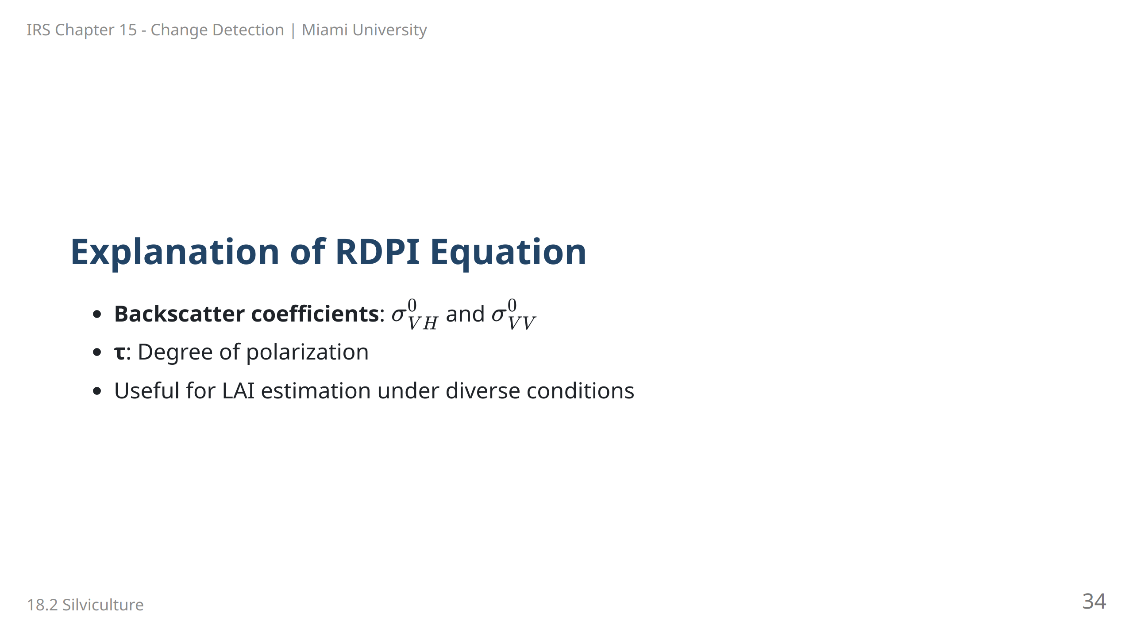
Notes:
Speaker Notes: The RDPI equation uses SAR backscatter coefficients to assess canopy density, providing a measure of LAI. This slide explains each component and the index’s utility across different environmental conditions.

Slide 35
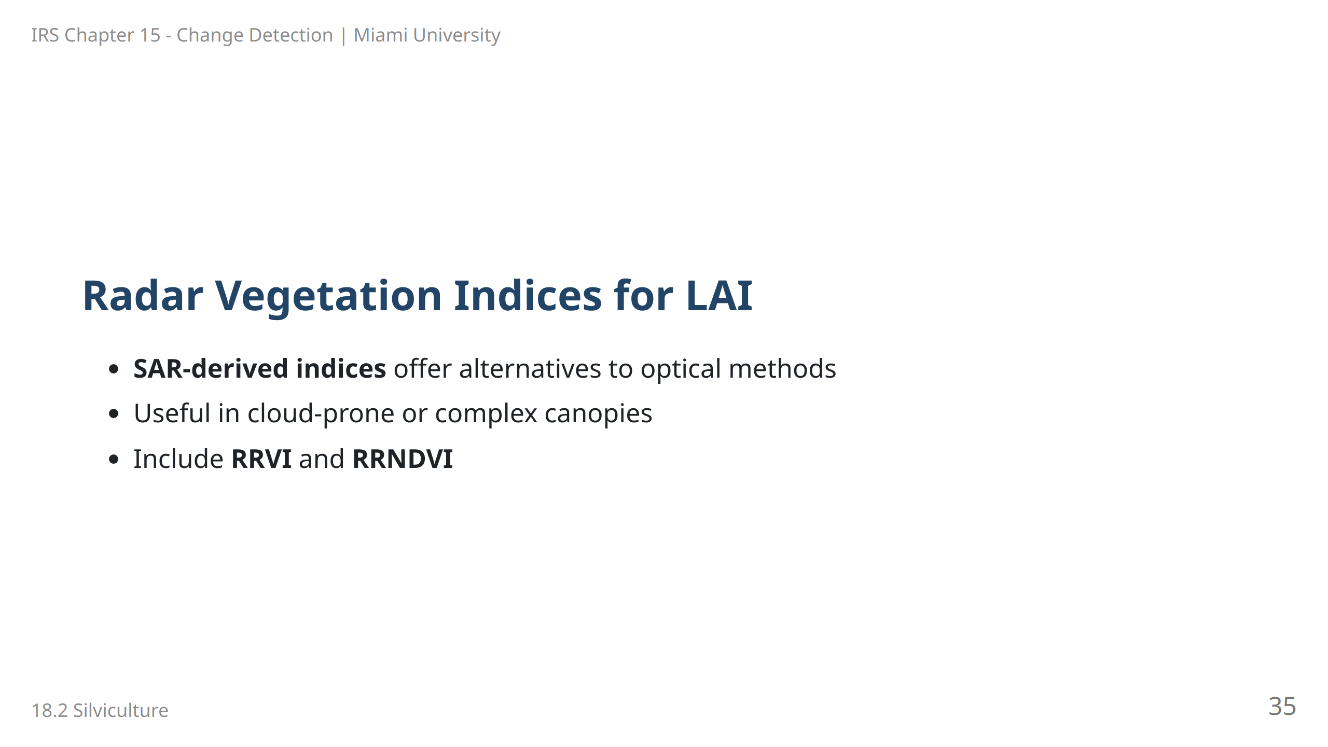
Notes:
Speaker Notes: Radar vegetation indices like RRVI and RRNDVI provide LAI estimates in scenarios where optical methods may not work, such as dense canopies or cloudy regions. These indices leverage radar data to measure canopy structure.

Slide 36
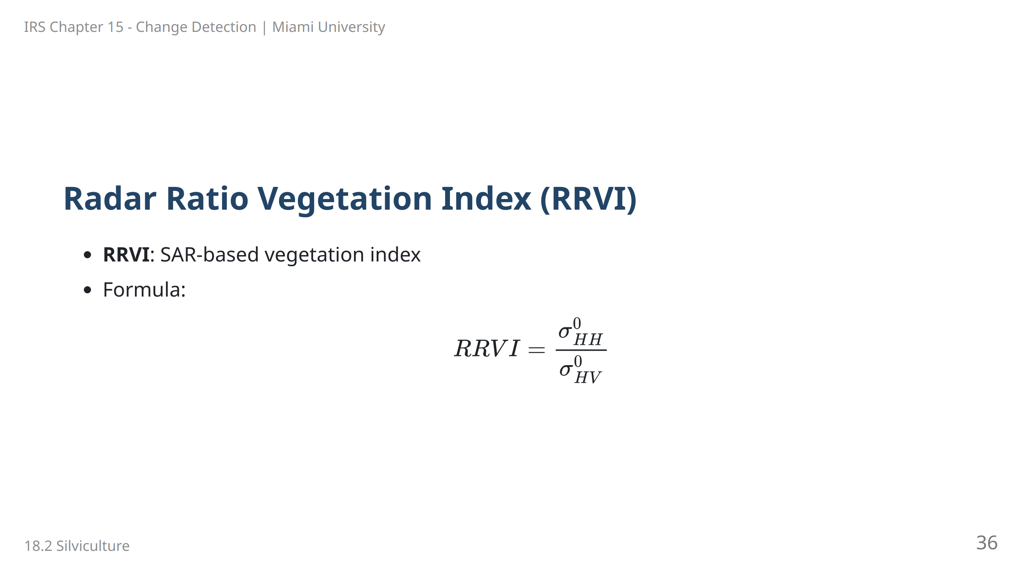
Notes:
Speaker Notes: The RRVI is a radar-based vegetation index that uses horizontal-horizontal (HH) and horizontal-vertical (HV) backscatter coefficients. This index is particularly useful for estimating LAI in regions with dense canopy cover.

Slide 37
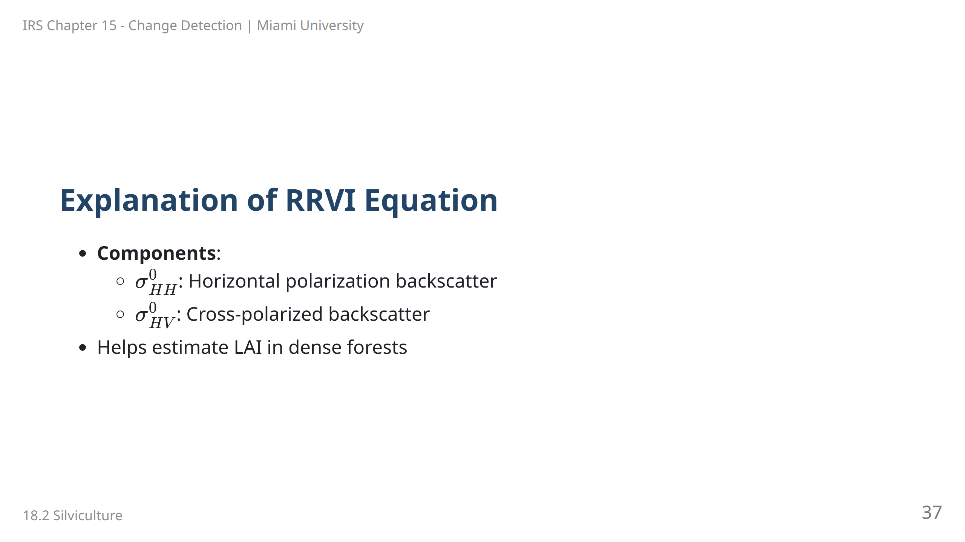
Notes:
Speaker Notes: RRVI utilizes backscatter coefficients from different polarizations to provide insights into forest canopy structure, aiding in LAI estimation. This slide explains how the ratio of HH and HV polarizations is applied.

Slide 38
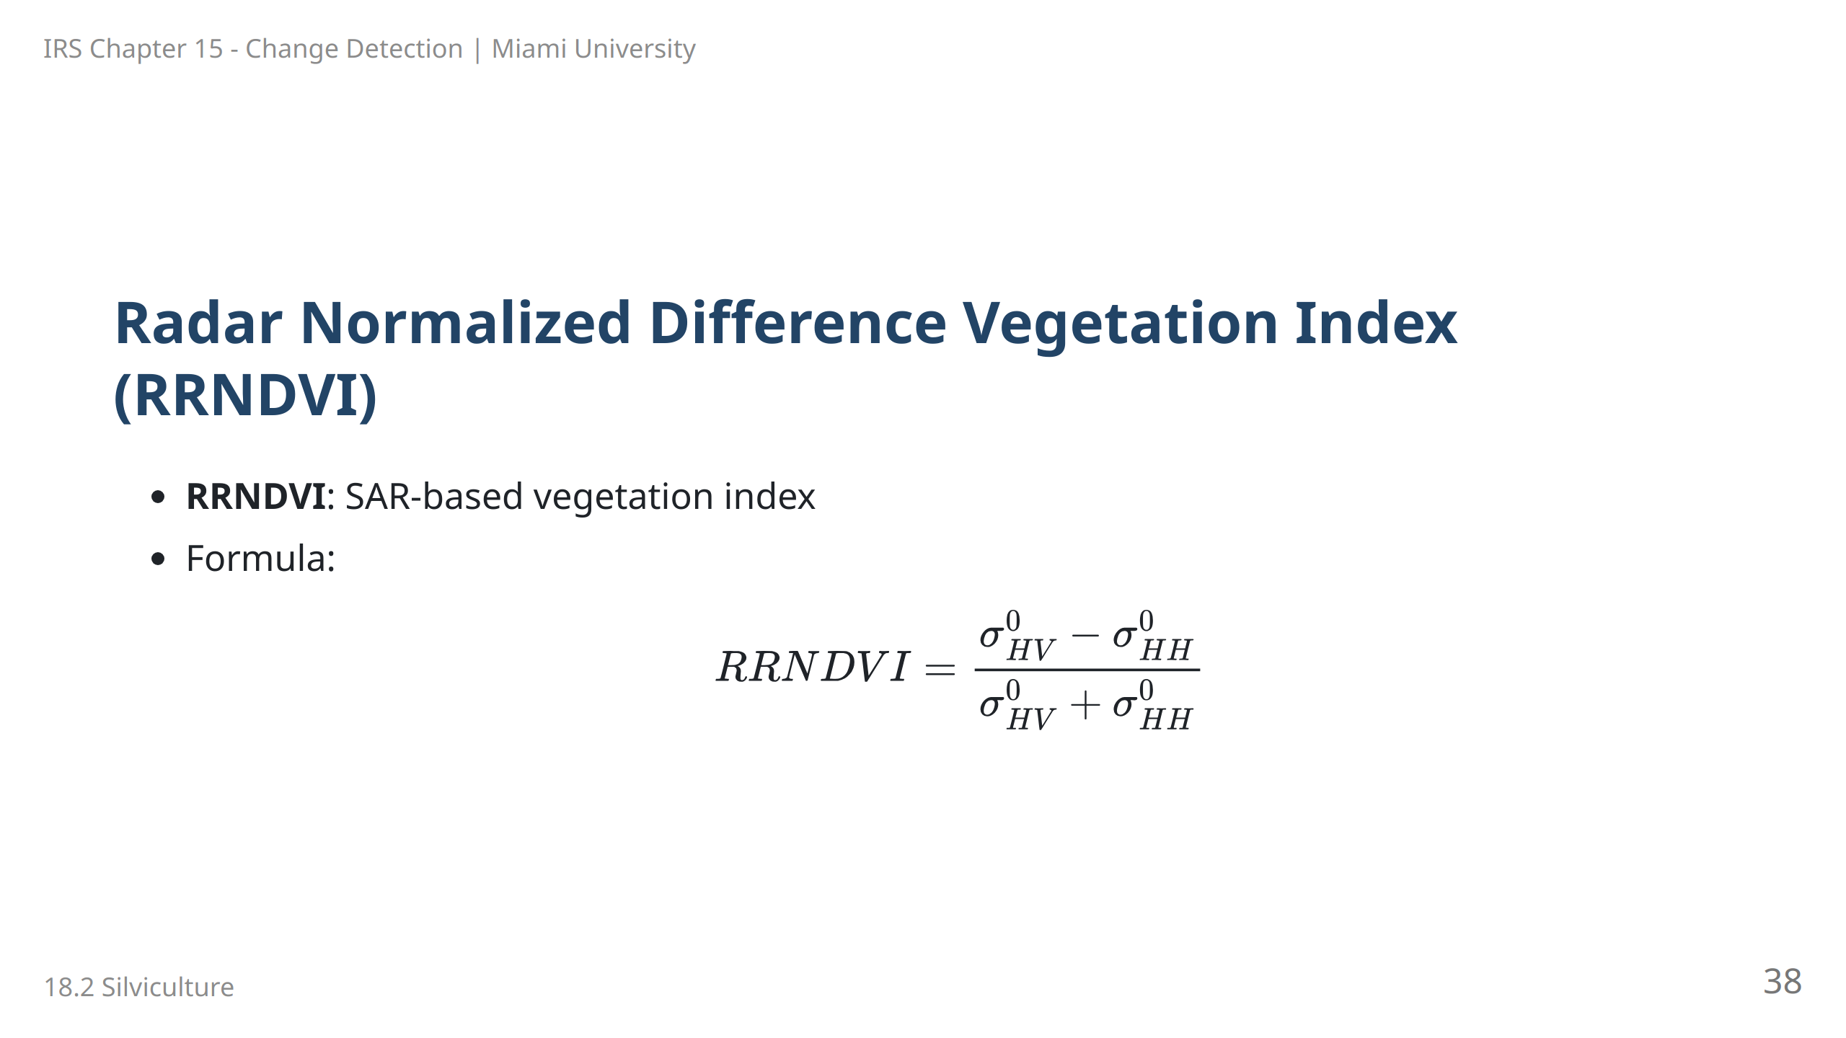
Notes:
Speaker Notes: The Radar Normalized Difference Vegetation Index (RRNDVI) leverages the difference between HV and HH polarizations to estimate vegetation density and structure, which are proxies for LAI.

Slide 39
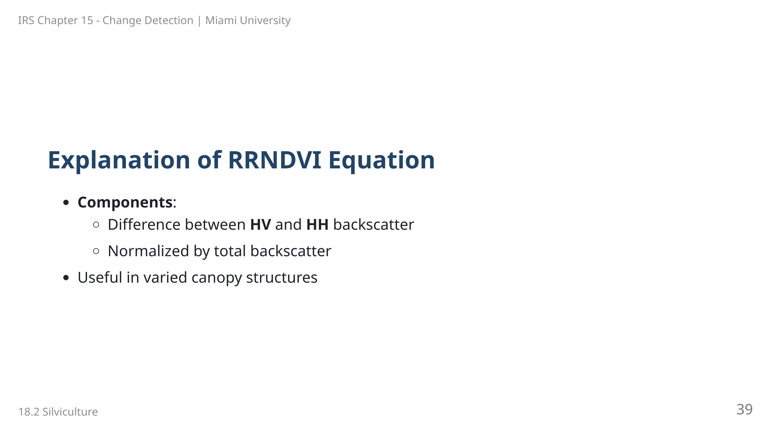
Notes:
Speaker Notes: RRNDVI is designed for areas with complex canopy structures, using the difference in backscatter from different polarizations. This index is particularly helpful for assessing forest canopy density.

Slide 40
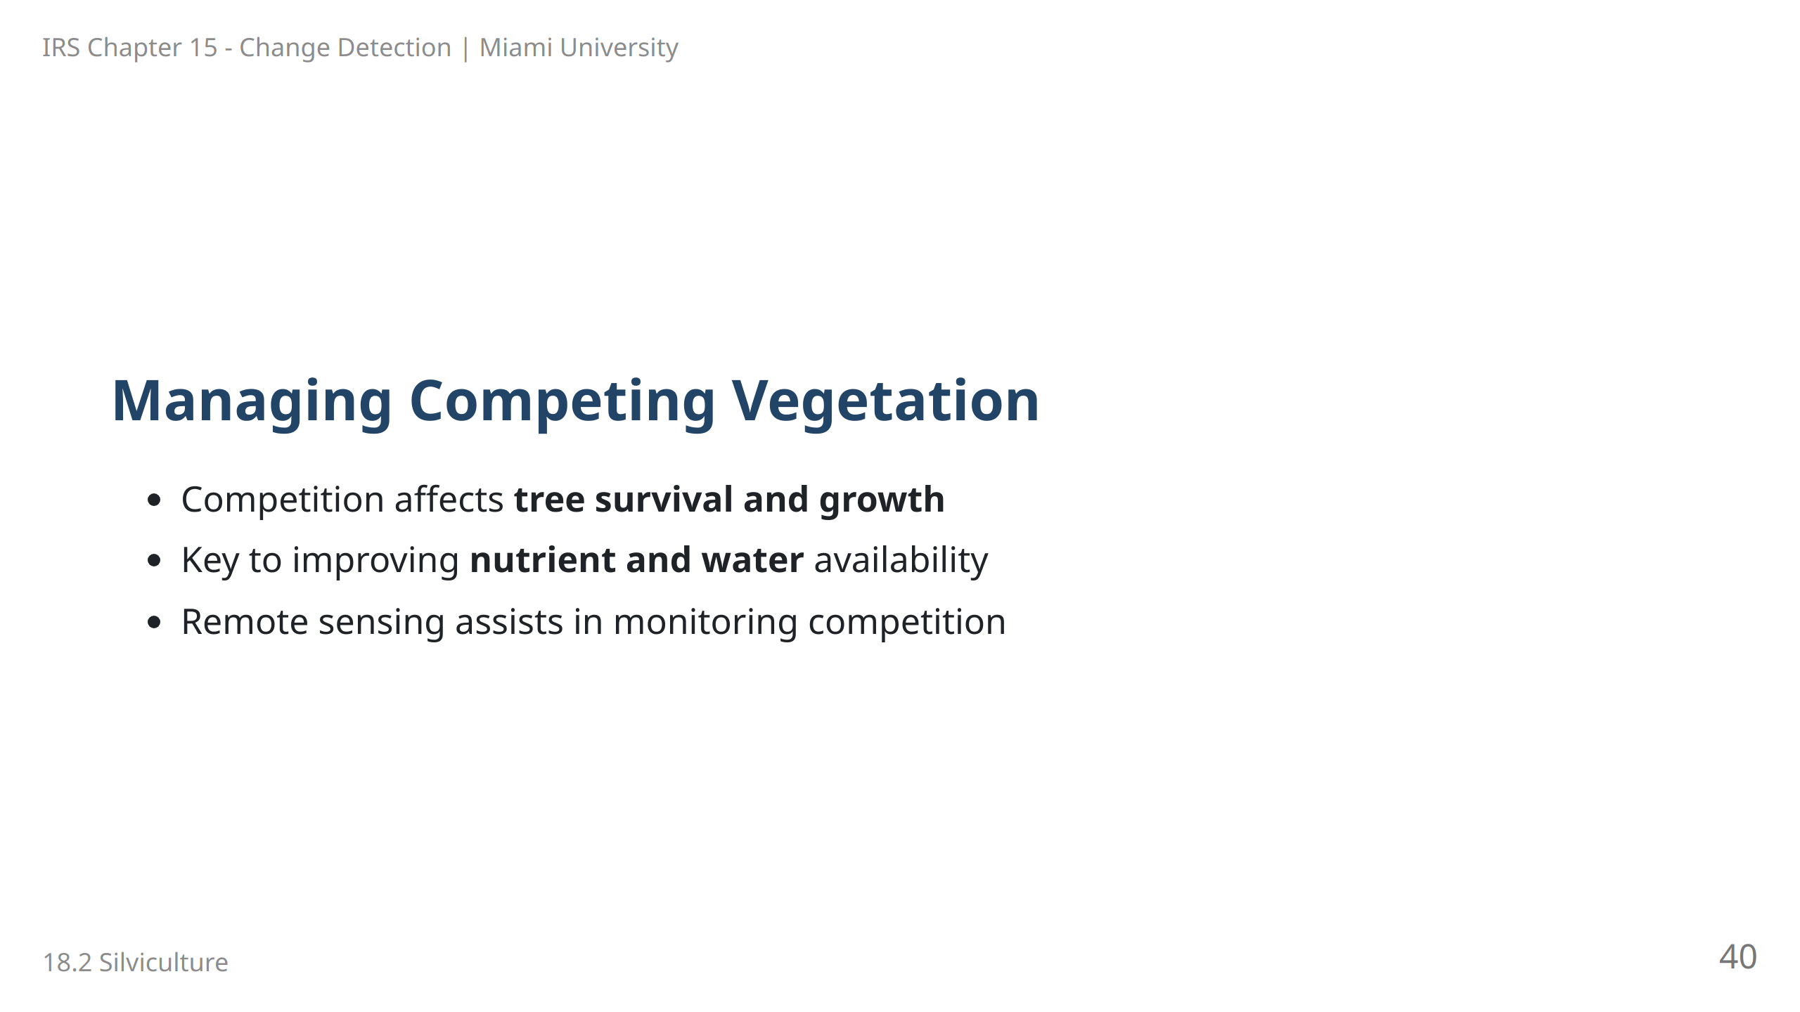
Notes:
Speaker Notes: Competing vegetation can reduce tree growth by consuming resources such as nutrients and water. Managing competition is therefore essential in forestry, and remote sensing provides tools to monitor and address these issues.

Slide 41
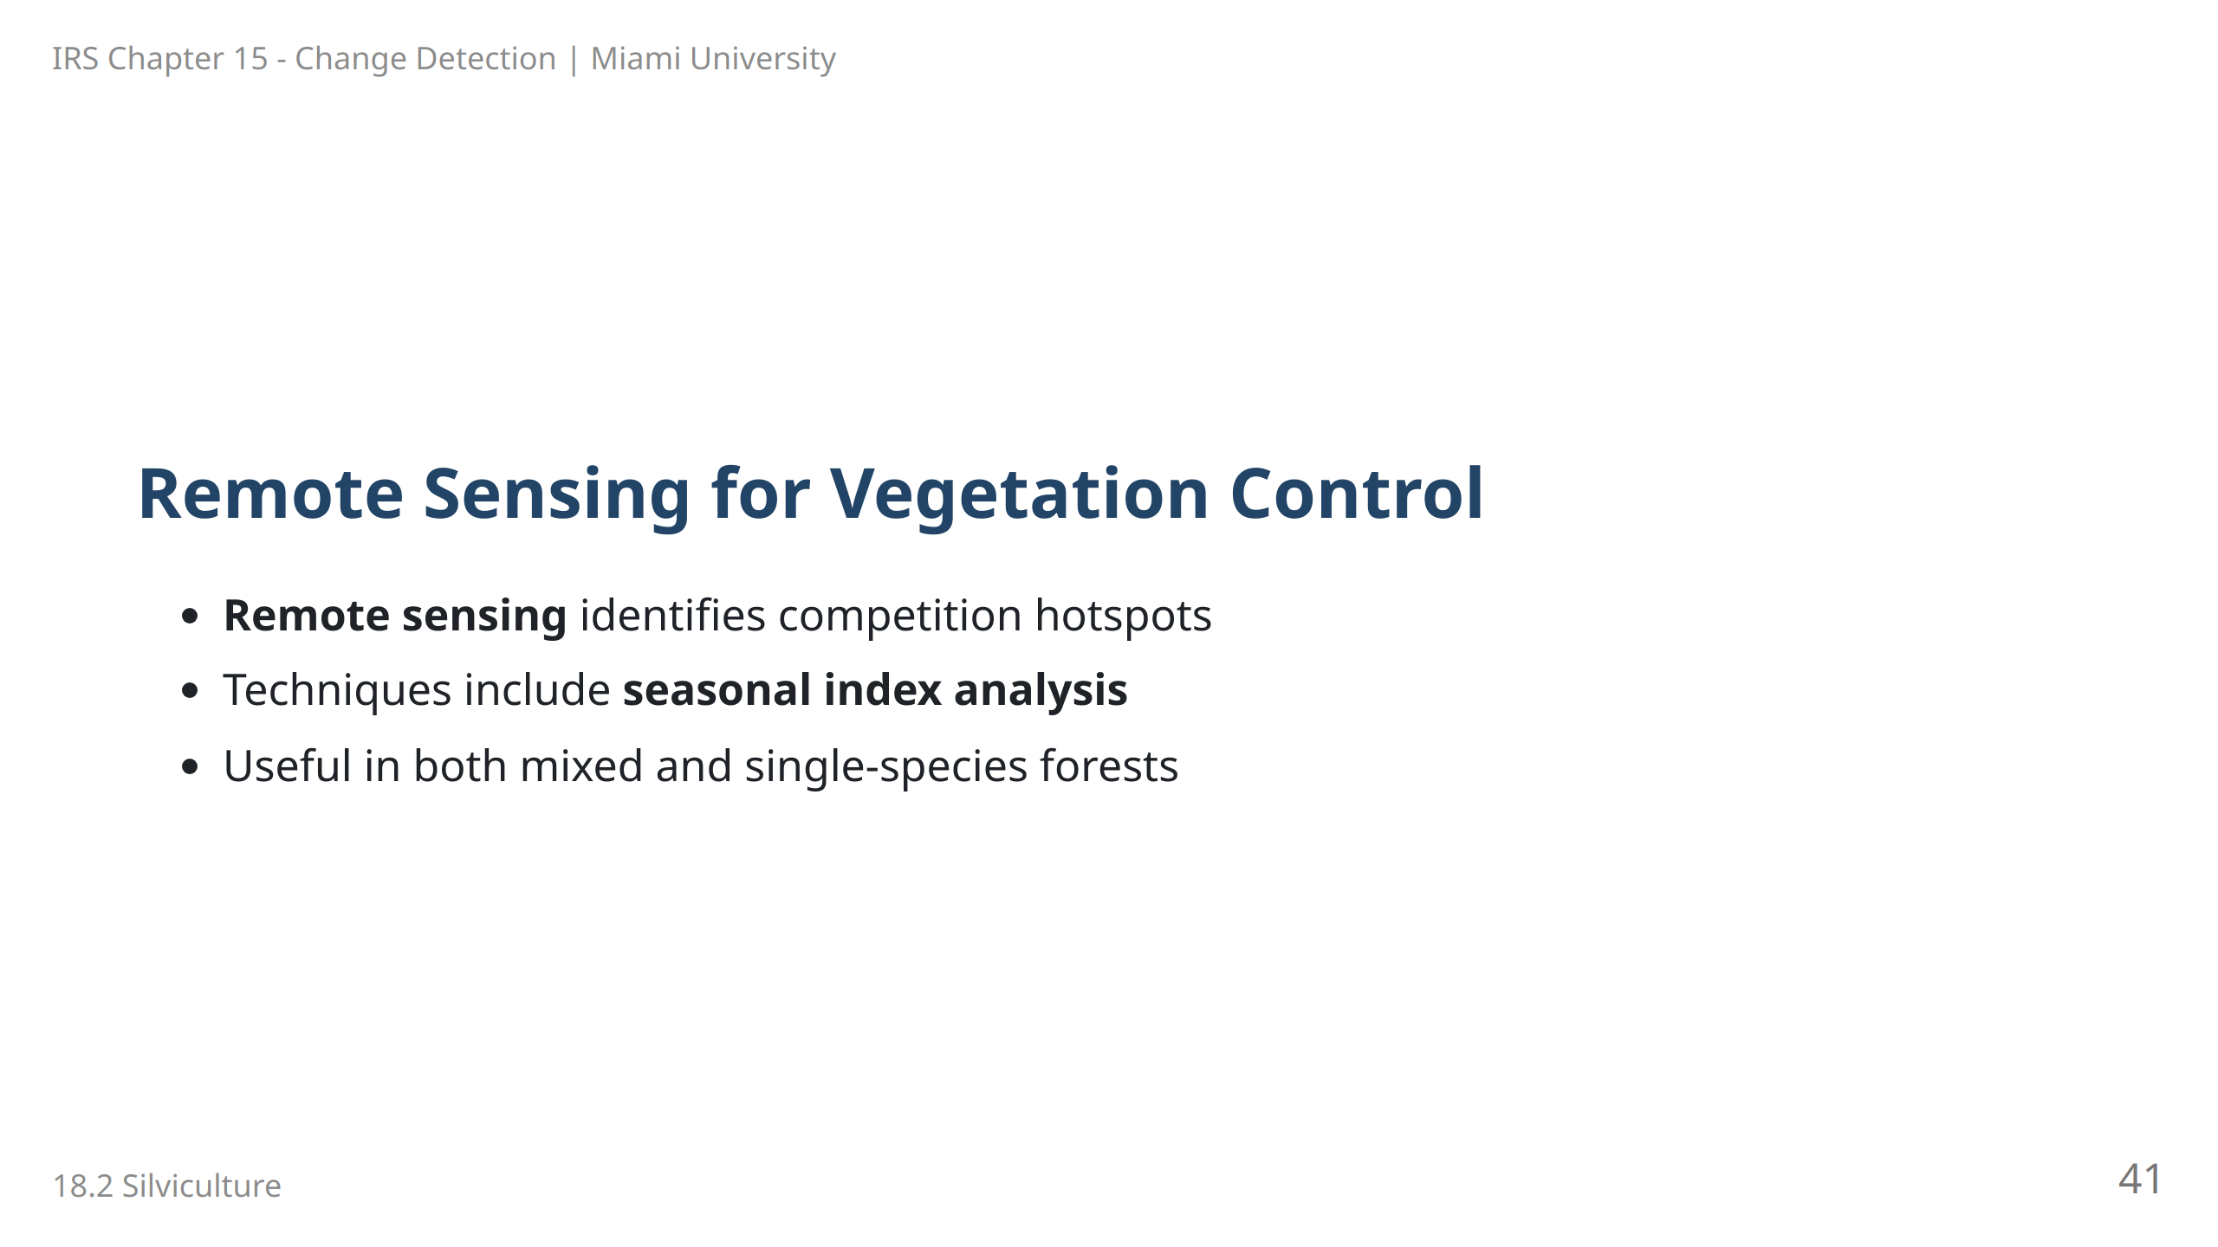
Notes:
Speaker Notes: Remote sensing is increasingly used to assess and control competing vegetation. Seasonal vegetation index analysis helps foresters identify areas where intervention is necessary, especially in mixed-species stands.

Slide 42
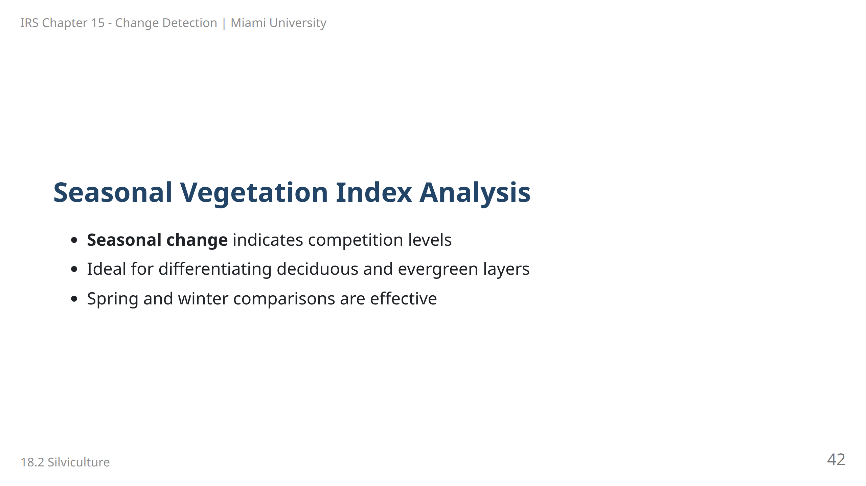
Notes:
Speaker Notes: Seasonal vegetation index analysis can help identify competing vegetation by observing changes in leaf area. By comparing indices across seasons, foresters can detect competition levels between canopy layers.

Slide 43
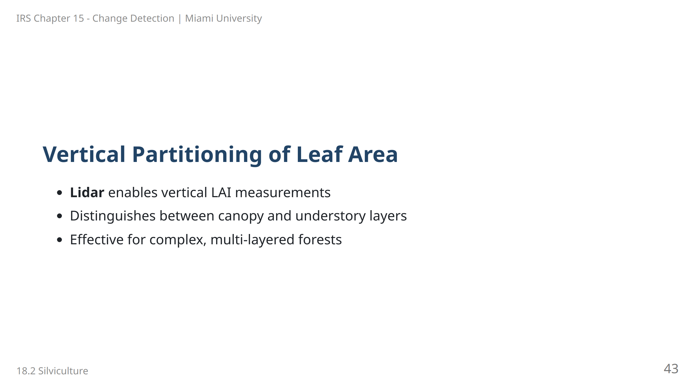
Notes:
Speaker Notes: Lidar technology enables partitioning of leaf area vertically, allowing foresters to analyze the canopy and understory separately. This is particularly useful in forests with dense, multi-layered structures.

Slide 44
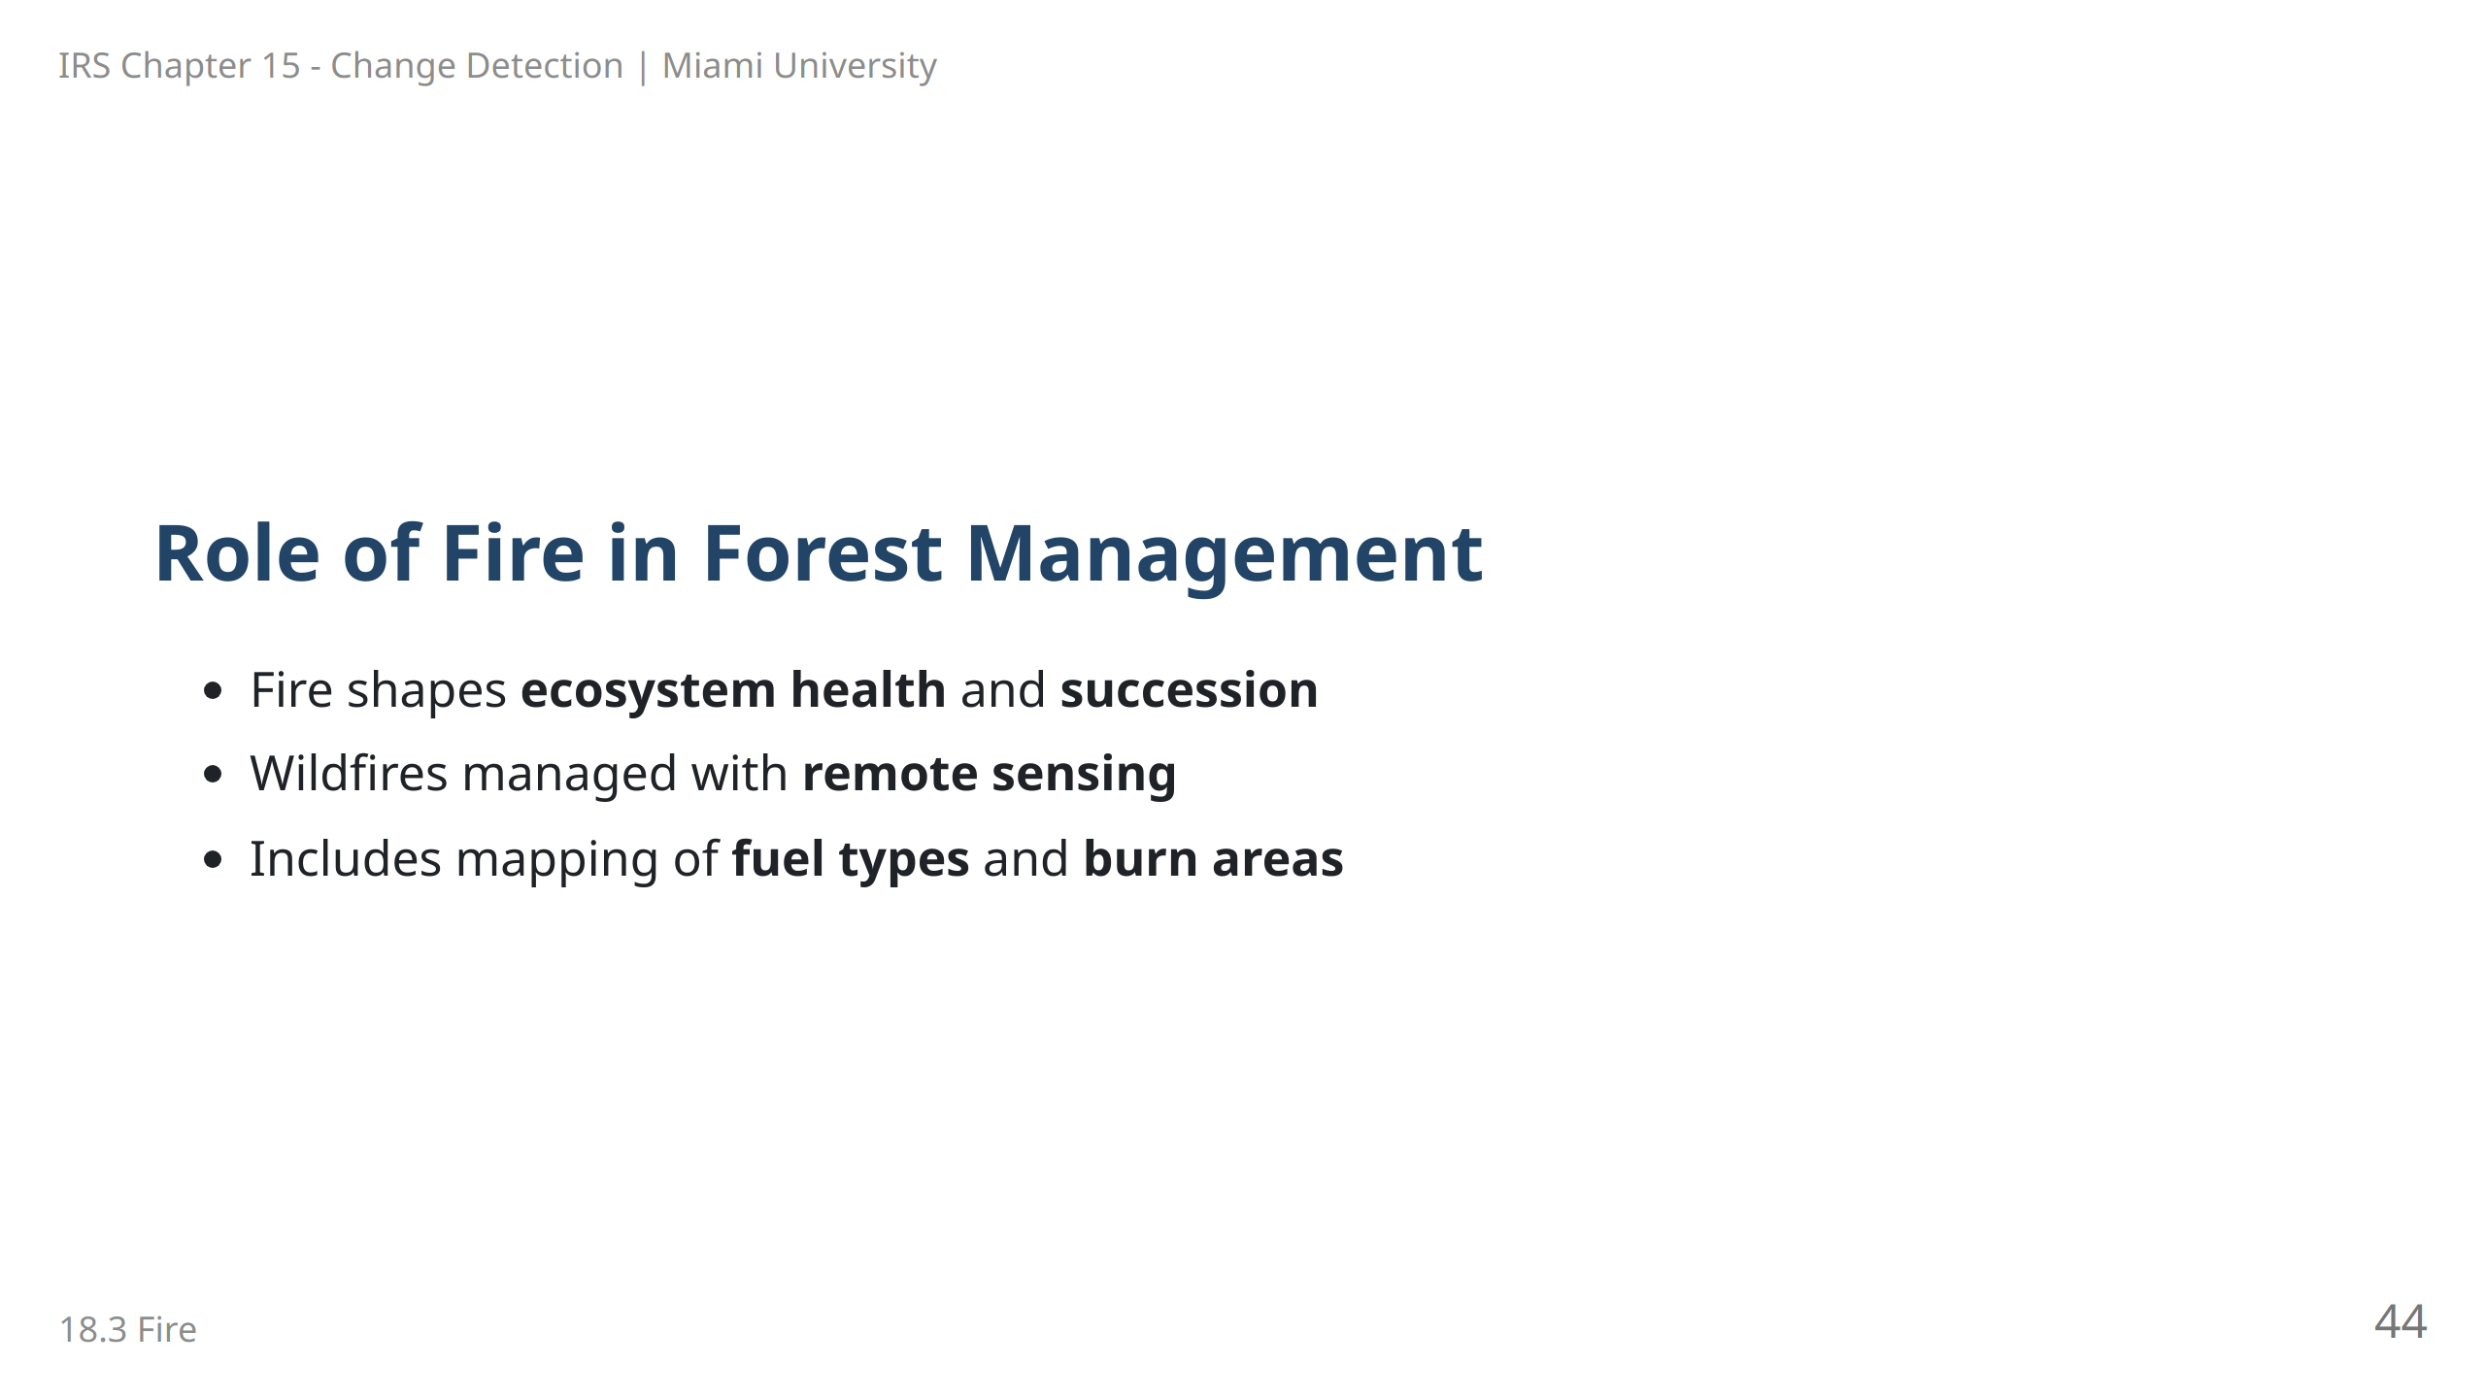
Notes:
Speaker Notes: Fire plays a crucial role in forest ecosystems, influencing succession and health. Remote sensing helps manage wildfires by mapping fuel types, active fires, and burn areas, aiding in both prevention and response.

Slide 45
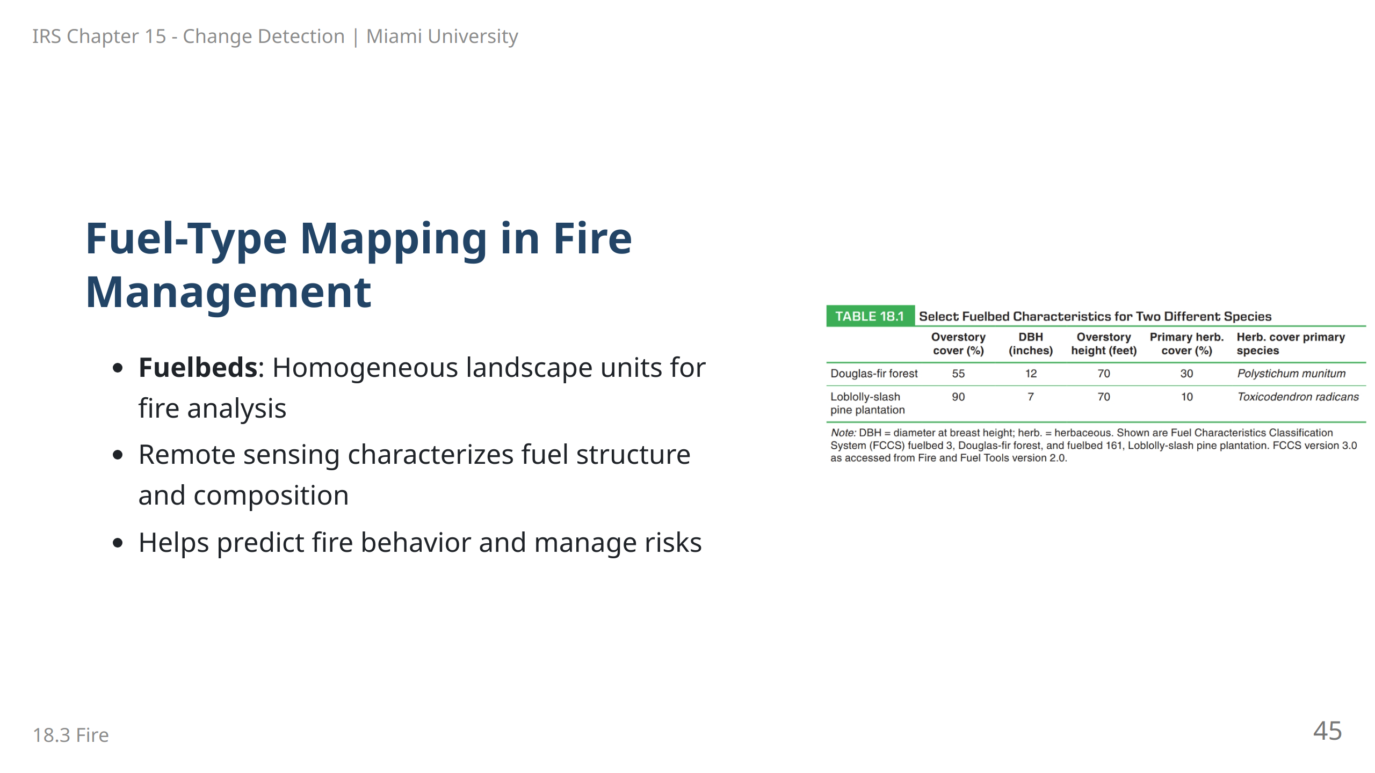
Notes:
Speaker Notes: Fuel-type mapping identifies areas with similar fire characteristics. By mapping these units, foresters can anticipate fire behavior and implement targeted management strategies to reduce risks.

Slide 46
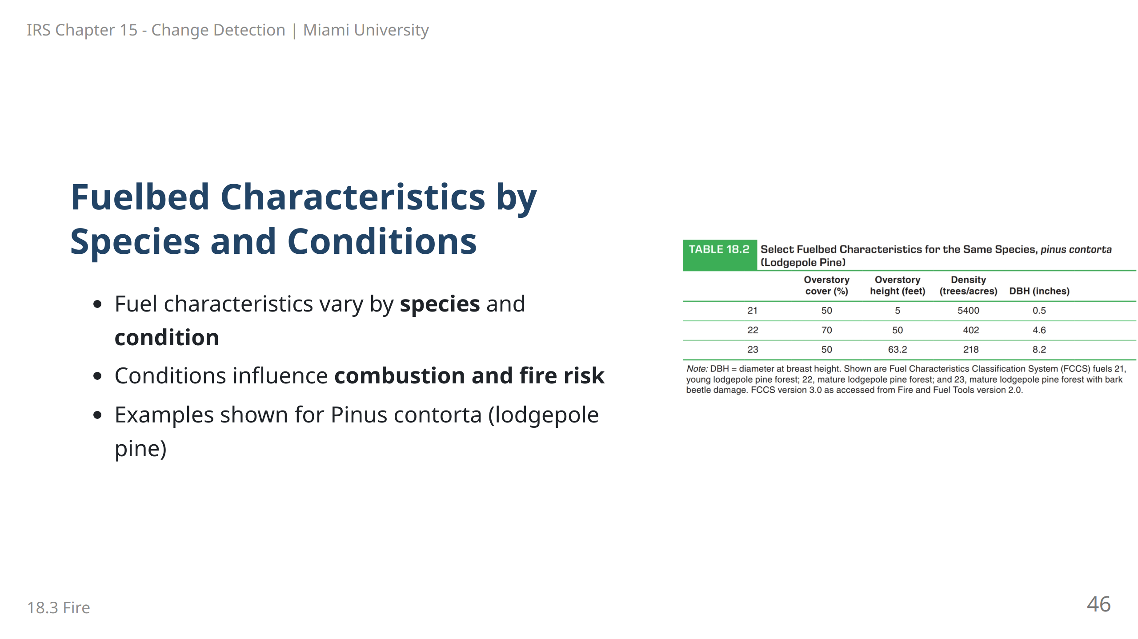
Notes:
Speaker Notes: Fuel characteristics depend on both species and specific site conditions, which determine combustibility. This slide shows different fuelbed characteristics for lodgepole pine under varying conditions.

Slide 47
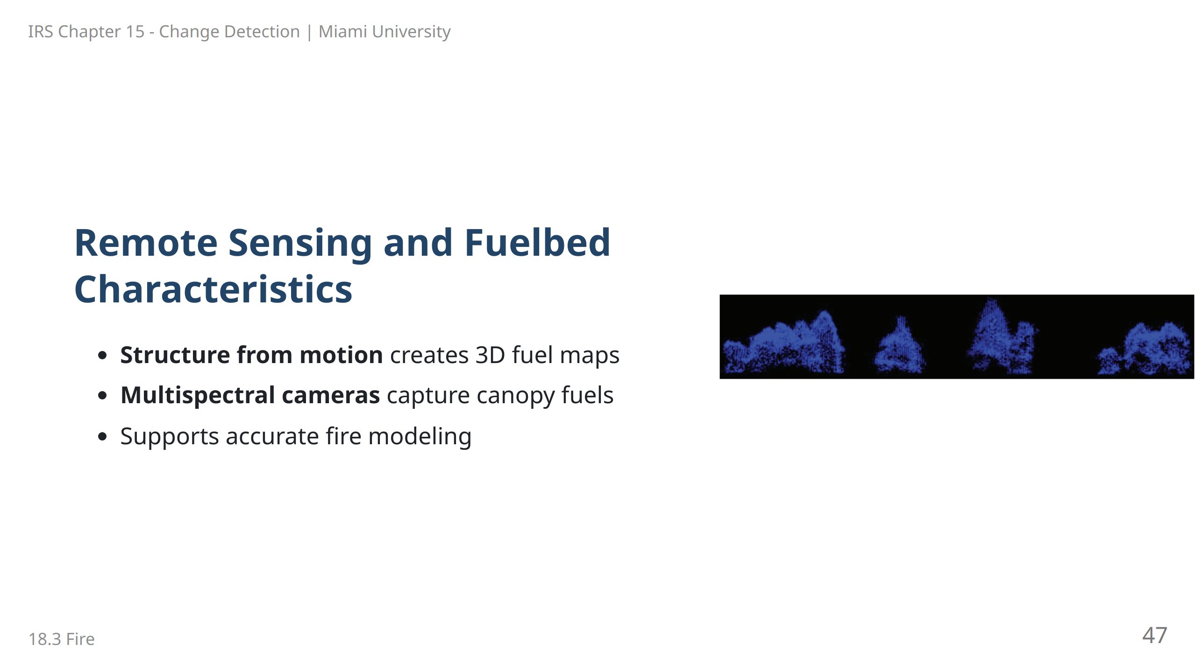
Notes:
Speaker Notes: Remote sensing techniques, including structure from motion and multispectral imaging, allow for detailed mapping of forest canopy fuels. This helps in fire risk modeling by providing comprehensive fuel data.

Slide 48
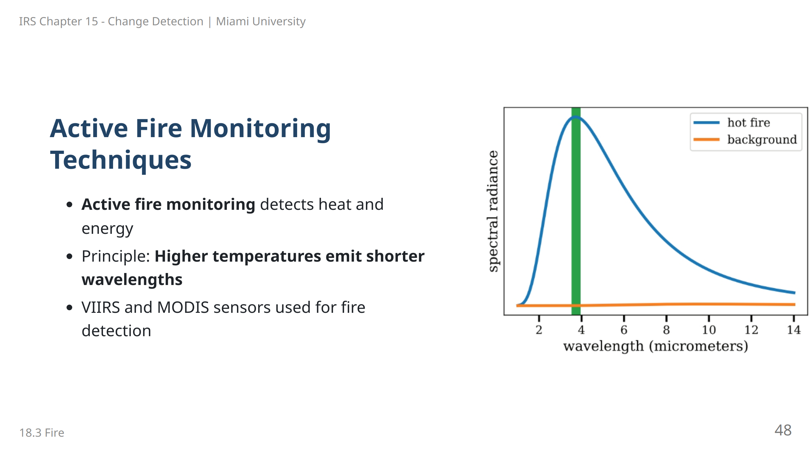
Notes:
Speaker Notes: Active fire monitoring utilizes the principle that hotter fires emit energy at shorter wavelengths. Sensors like VIIRS and MODIS detect these changes, aiding in fire detection and management.

Slide 49
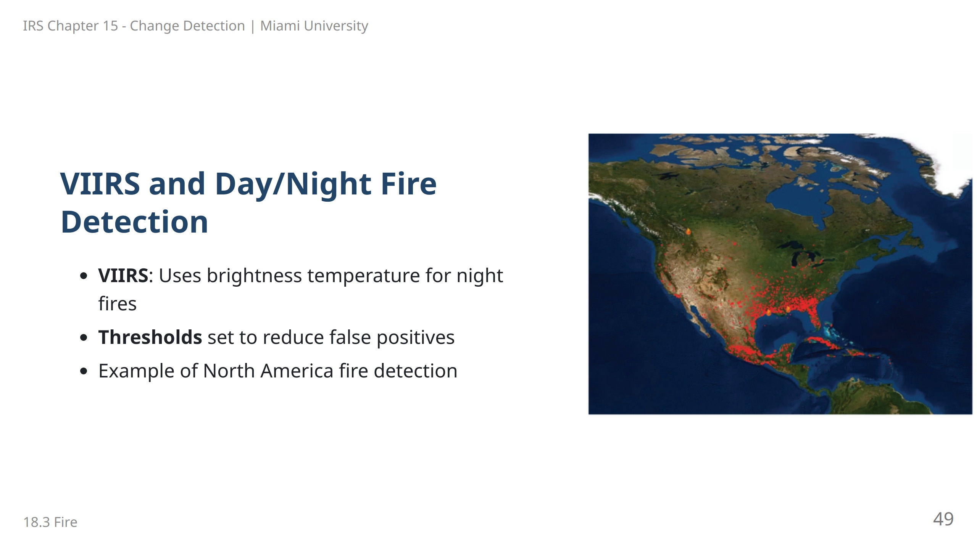
Notes:
Speaker Notes: VIIRS is a valuable tool for detecting active fires, especially at night. By setting brightness temperature thresholds, it minimizes false positives while capturing accurate fire data, as shown in this example.

Slide 50
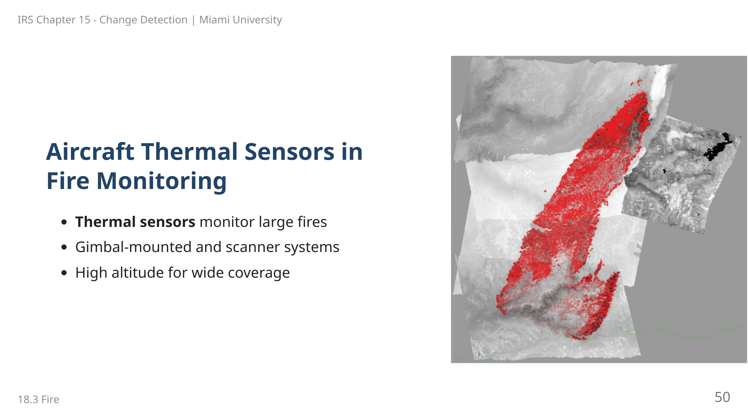
Notes:
Speaker Notes: Aircraft-mounted thermal sensors provide high-resolution data for large fire areas. These systems cover extensive areas, helping with fire mapping and response in remote or rugged terrains.

Slide 51

Notes:
Speaker Notes: Identifying tree species is a foundational skill in forestry. Species can be identified by observing crown characteristics, shadows, and texture patterns, which provide clues about individual tree types.

Slide 52

Notes:
Speaker Notes: The shape and shadow of a tree crown help foresters identify species. This slide shows how the distinct crown structures and shadows assist in differentiating between tree types.

Slide 53

Notes:
Speaker Notes: Forest photogrammetry, using stereo aerial photography, allows for precise measurement of stand characteristics like tree volume and growth, crucial for inventory and management purposes.

Slide 54

Notes:
Speaker Notes: Crown closure is an important measure of stand density and competition, affecting growth potential and productivity. High crown closure often indicates a densely populated forest with limited resources per tree.

Slide 55

Notes:
Speaker Notes: Timber volume estimates are essential for economic assessments in forestry. Measurements like DBH (diameter at breast height) and height are standard, while aerial methods offer broader estimates for entire stands.

Slide 56

Notes:
Speaker Notes: Lidar is a highly accurate tool for capturing the 3D structure of forests. Its ability to measure variables like height and crown closure makes it essential for forest inventory and monitoring.

Slide 57

Notes:
Speaker Notes: This chapter highlights sustainable forest management goals, which include optimizing productivity, conserving biodiversity, and managing fire risks. Modern tools like remote sensing are integral to achieving these objectives.

